Slide 1
Ethan Hu 2024 Summer at Sym Geno Evo Lab

Slide 2
Overview
Summary of Phylogeny Tree and BRAKER installation
Literature Reviews
Yabin Guo, An overview on the DNA nucleotide compositions across kingdoms
James C. Schnable, Genes and gene models, an important distinction
Macrosynteny Plot
Results
Future Work

Slide 3
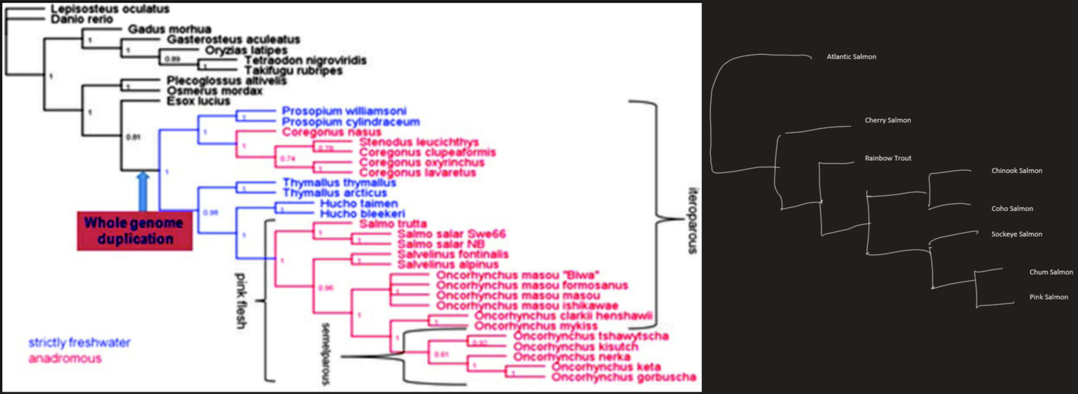
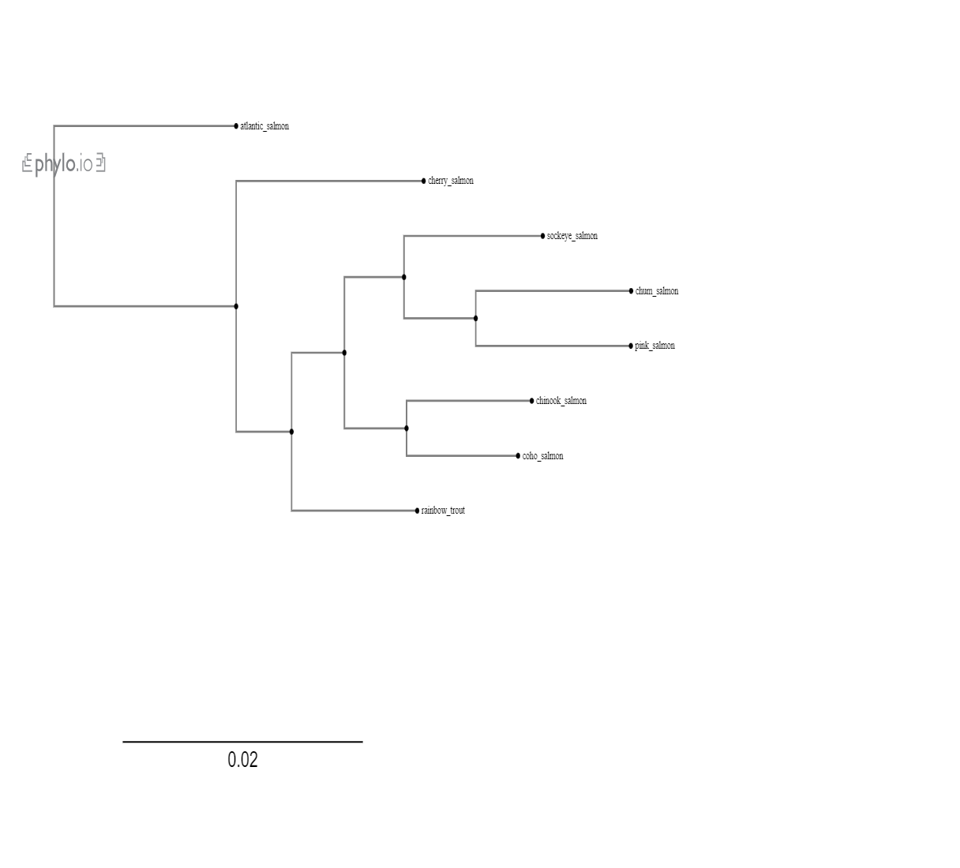
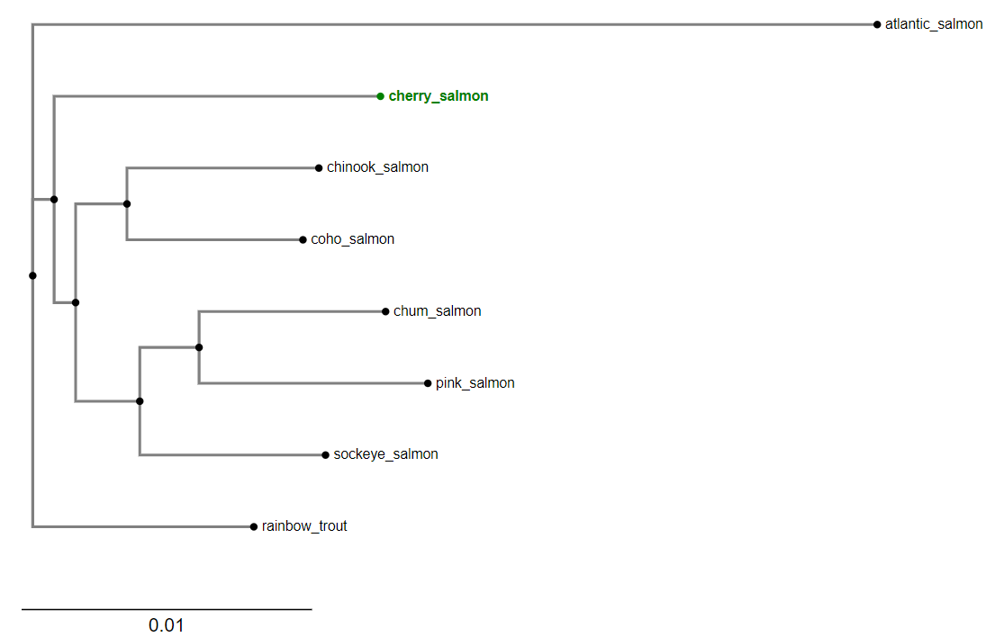
Summary of Phylogeny Tree and BRAKER install
Things of Interest:
Phylogeny Tree pipeline doesn’t work as well for closely related species
BRAKER3 installation:
When installing perl in conda, had to use version 5.26.2, to accommodate for perl scalar util numeric
StringTie2, Bedtools, GFFRead, Diamond, SRA Toolkit, samtools all in Genemark-ETP tools
When using compleasm in BUSCO mode, delete the Darwin folder in sepp/tools/bundled
Davidson, William S. Genome, vol. 56, no. 10, Oct. 2013, pp. 548–550, doi:10.1139/gen-2013-0163.
Orthofinder Tree
Full Pipeline

Slide 4
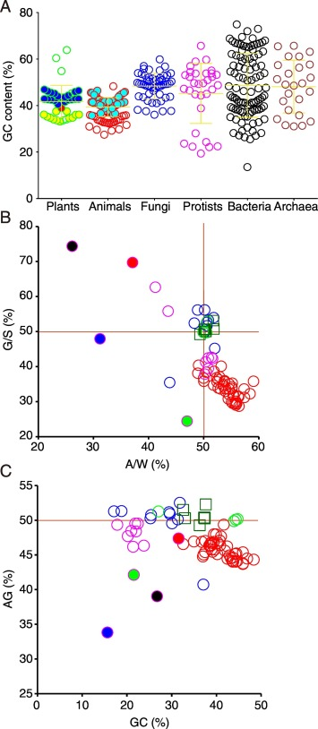
Literature Review
Category | Properties
GC | - Triple Hydrogen Bond
AT | - Double Hydrogen Bond
Purine (AG) | Double Ring Heavier
Pyramidine (CT) | Single Ring Cheaper to produce
An overview on the DNA nucleotide compositions across kingdoms
Yabin Guo, Gene Reports
GC content: Proportion of GC in DNA strand
Chargaff’s first rule, # of G=# of C, # of A = # of T
GC skew and AT skew: (G-C)/(G+C) and (A-T)/(A+T), measures asymmetry of the nucleic acids
Chargaff’s second rule, G/C ~ 1, A/T ~ 1
Substitution Rule
Symmetry is higher entropy
Purine content: Proportion of AG in DNA strand
Szbalski’s rule, DNA template strands have higher purine content <- politeness hypothesis
Conclusion
Chargaff’s second rule holds true
Some protists have asymmetric chromosomal strands
Asymmetric satellite DNA regions occurred in some animal genomes
Szybalski’s rule is not universal, purine richness of coding regions due to energy requirements
Thermophilicity is correlated to both genome GC content and CDS AG% in archaea
Notes:
Compared the GC content, AG content, and G/(G+C) Skew for different species, by genome, coding domain sections, and UTR

Slide 5
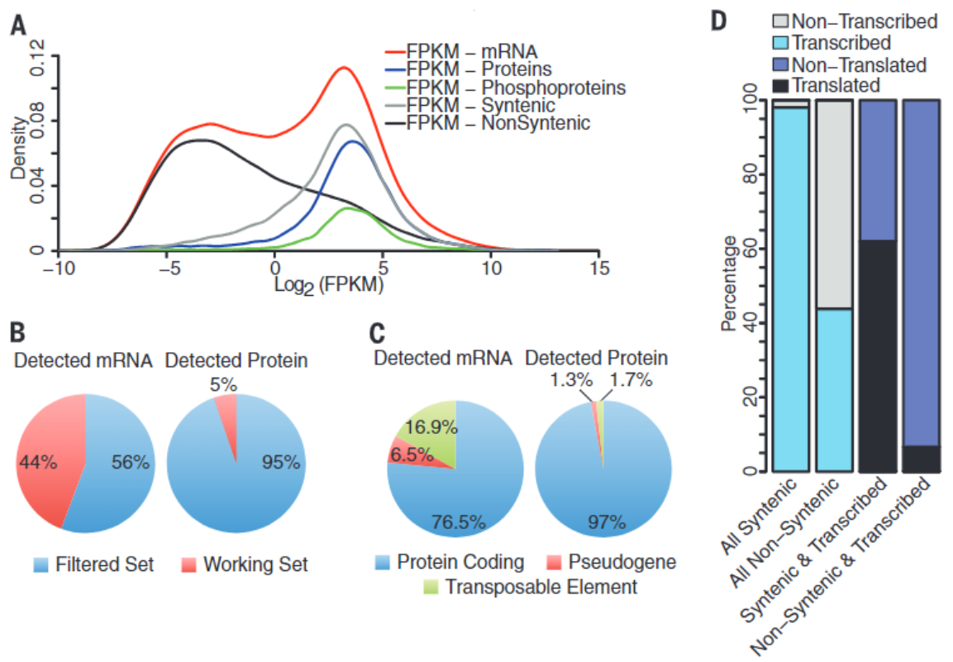
Literature Review
Genes and gene models, an important distinction
James C. Schnable, Tansley Insight in New Phytologist
Johanssen Gene
"the word Gene is completely free from any hypothesis, it only expresses the assured fact that, at any rate, many characteristics of the organism are conditioned by special, spearable, and therefore self-existent fundamentals that occur in the gametes.“
> chance syntenic
> expression in RNA
Gene Model
Region of genome transcribed to RNA
Defined by:
evidence of transcription or translation
homology to previously annotated gene
identified through machine learning
> presence absence variation

Slide 6
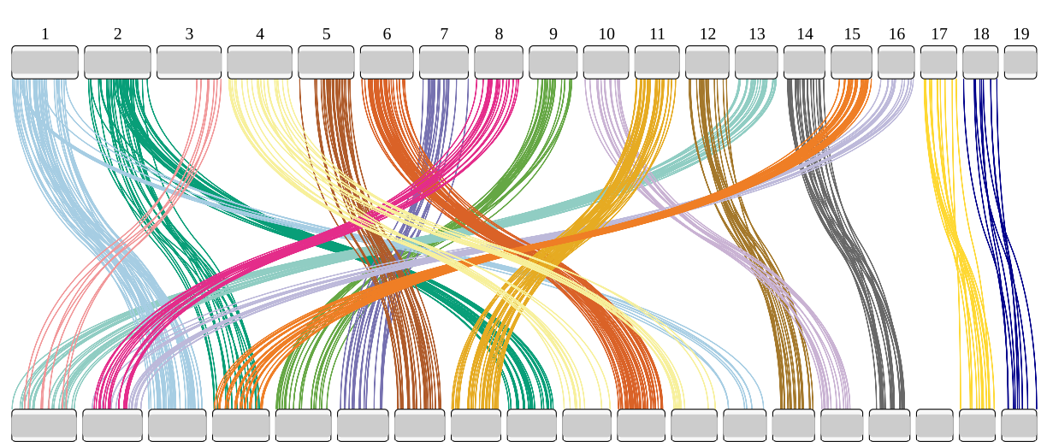
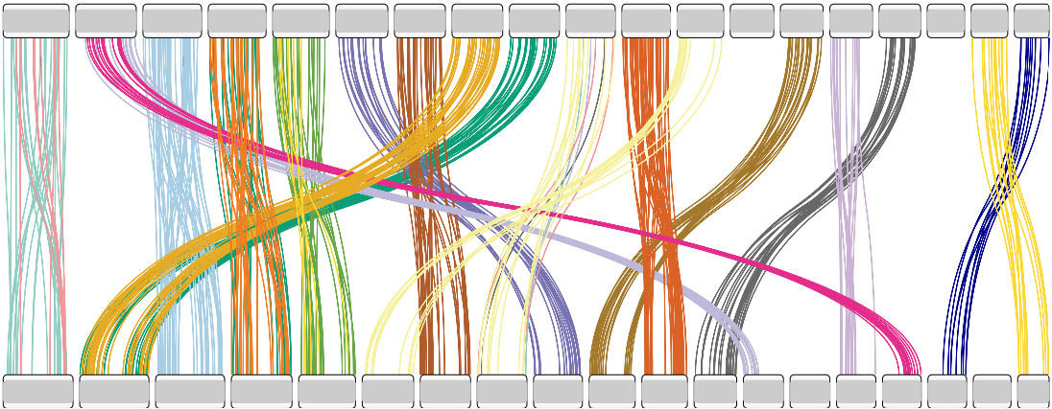
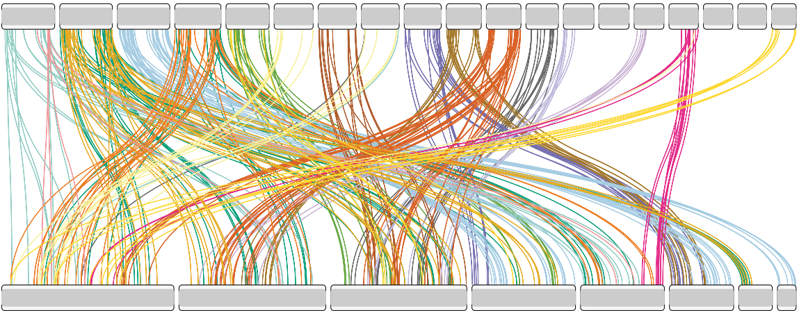
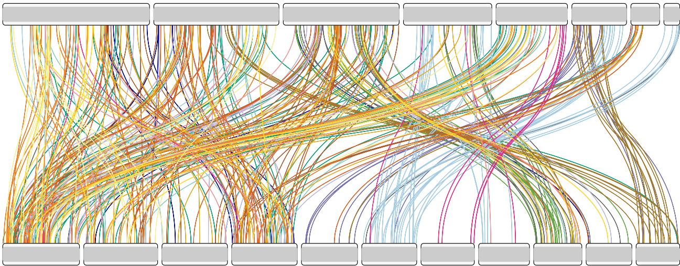
Macrosynteny Plot
Name | Source
B. floridae, Bfl | Ferdinand Marlétaz's lab + SyntenyFinder default
P. maximus, Pma | NCBI
L. longissimus, Llo | NCBI
C. mucedo, Cmu | GEO + Dryad
M. membranacea, Mme | NCBI + Dryad
Bfl
Pma
Llo
Cmu
Mme

Slide 7
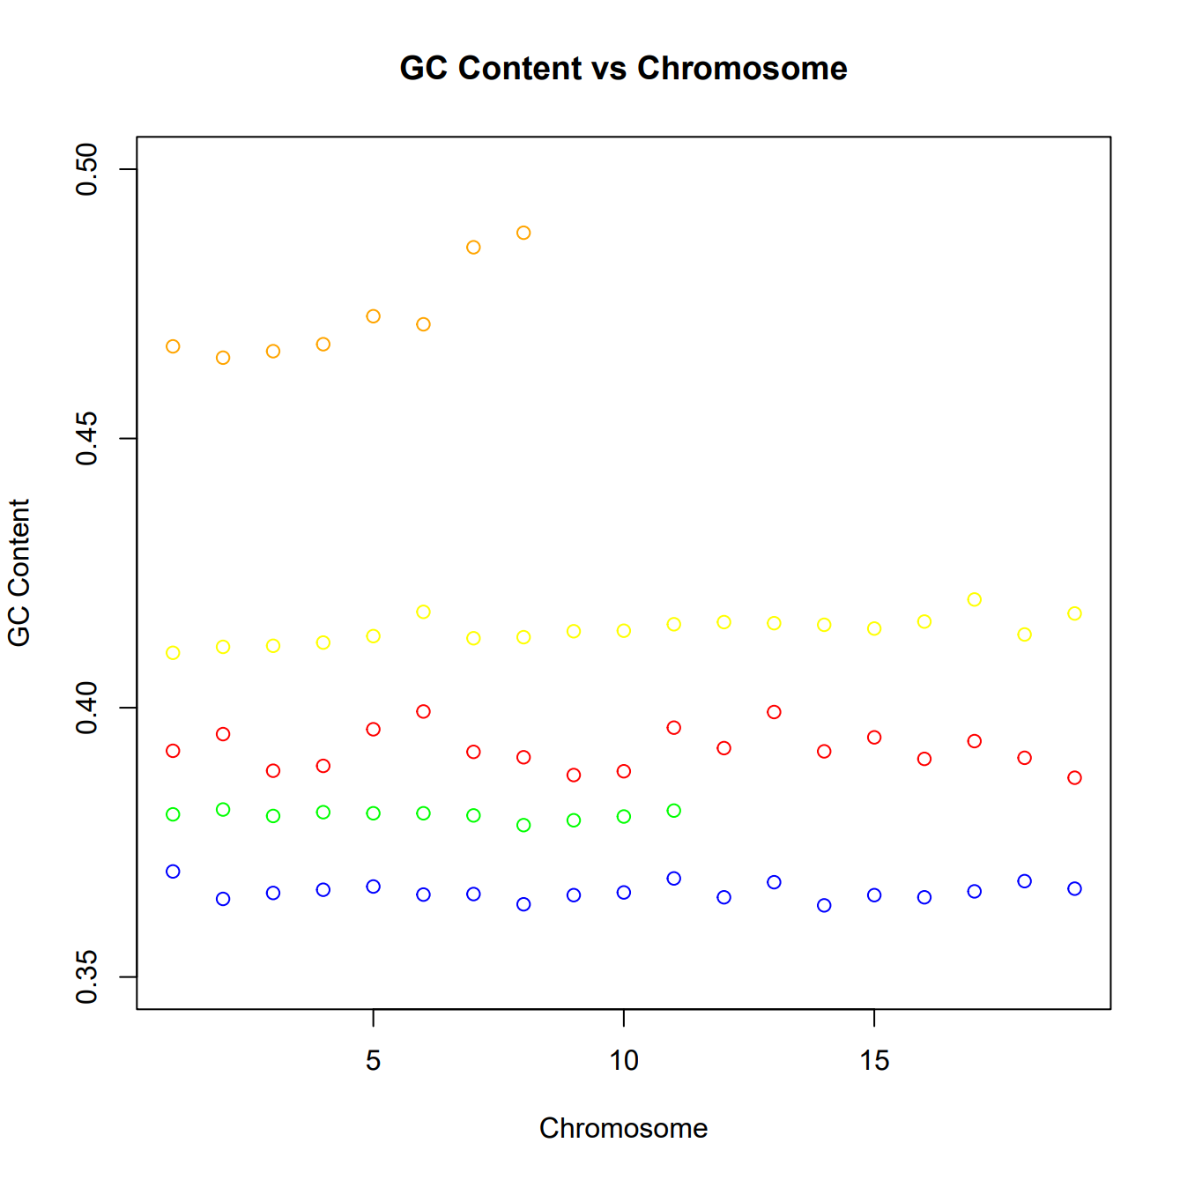
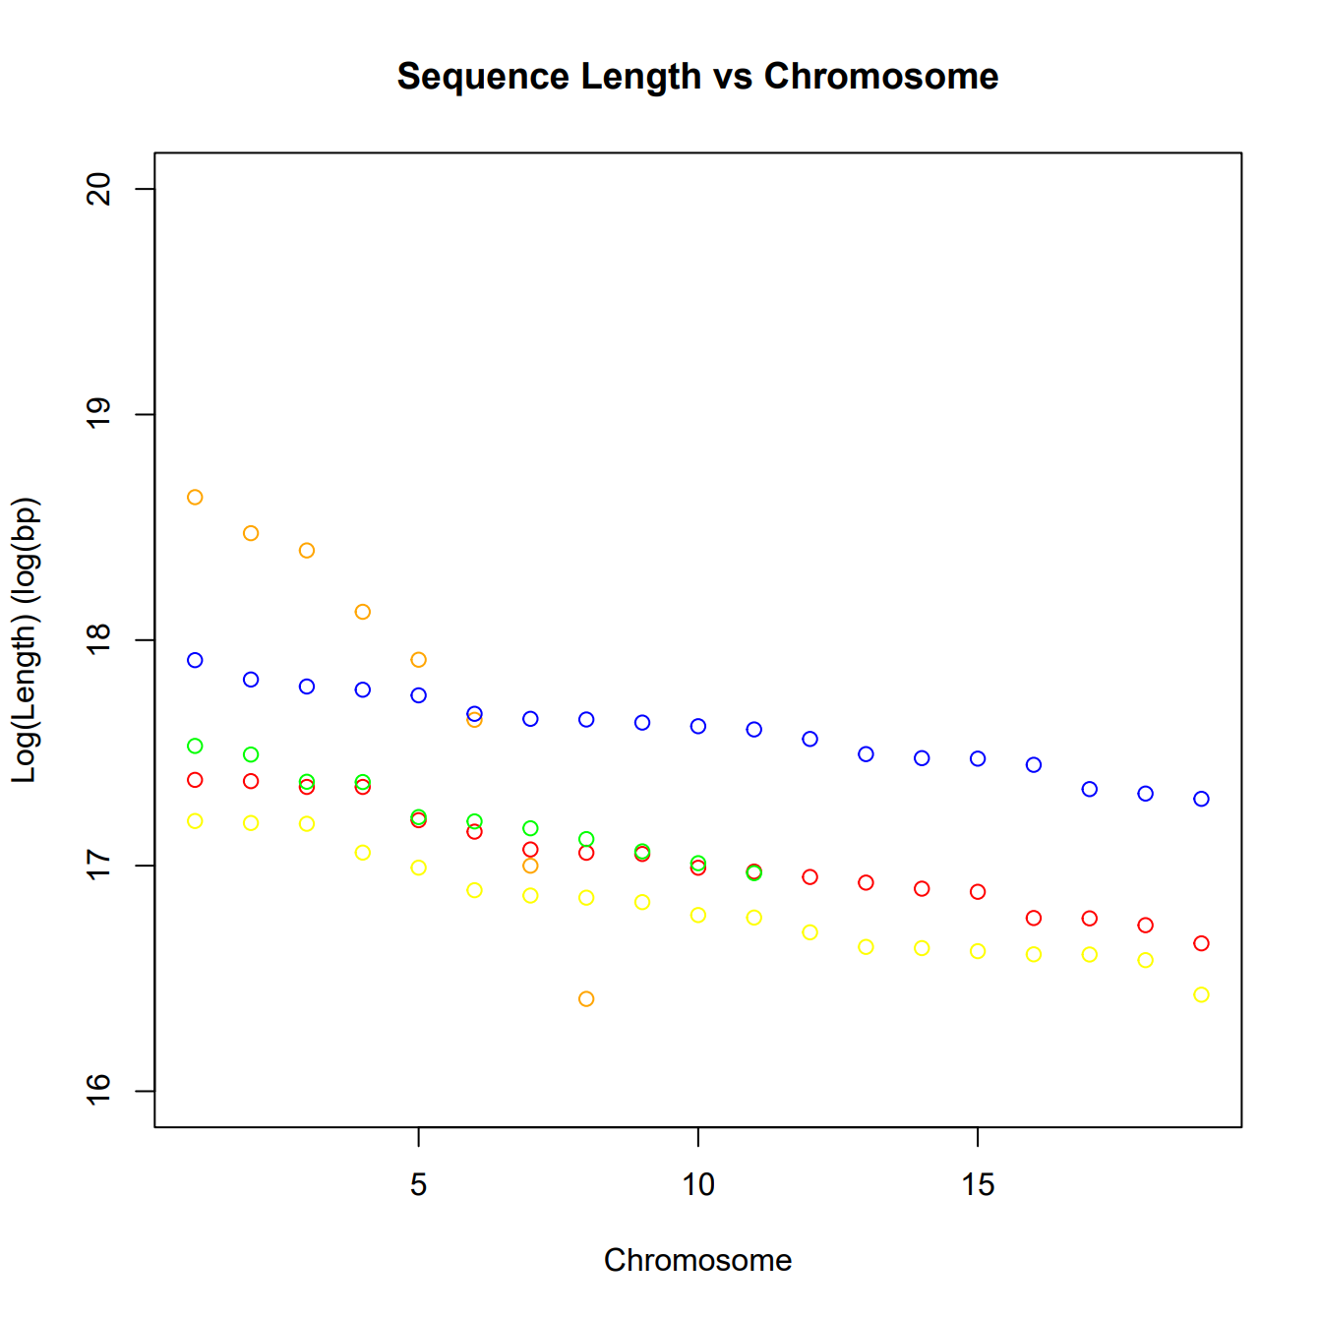
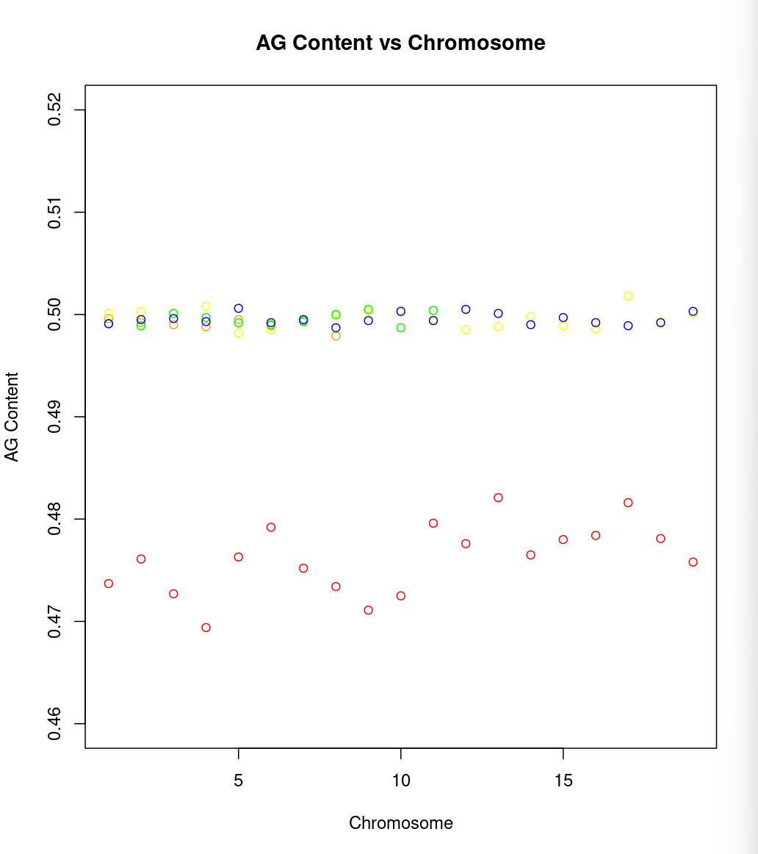
Bfl, Pma, Llo, Cmu, Mme
Notes:
Look for trends across one orthogroup

Slide 8
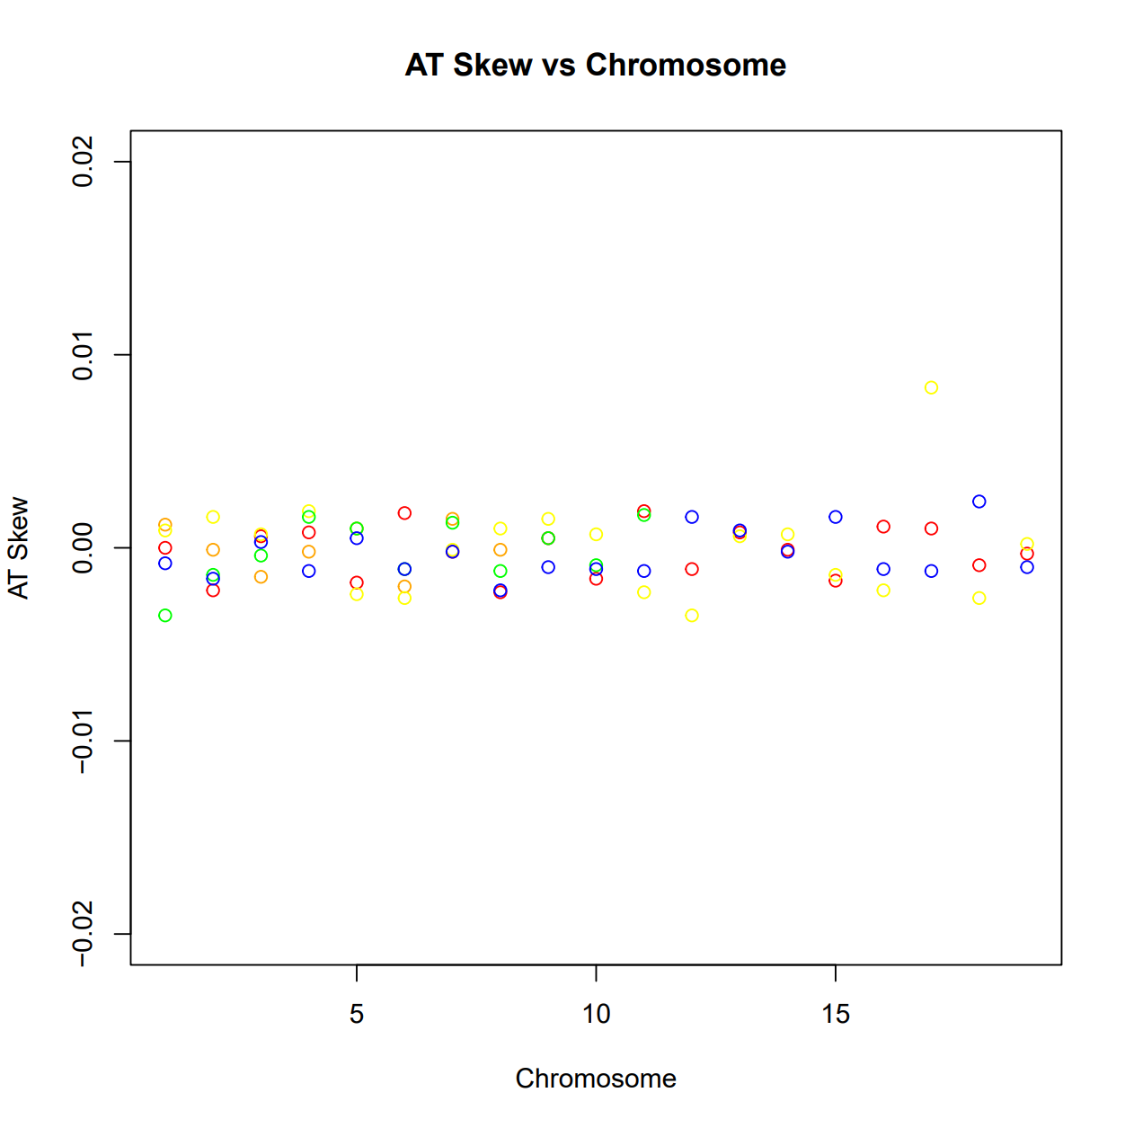
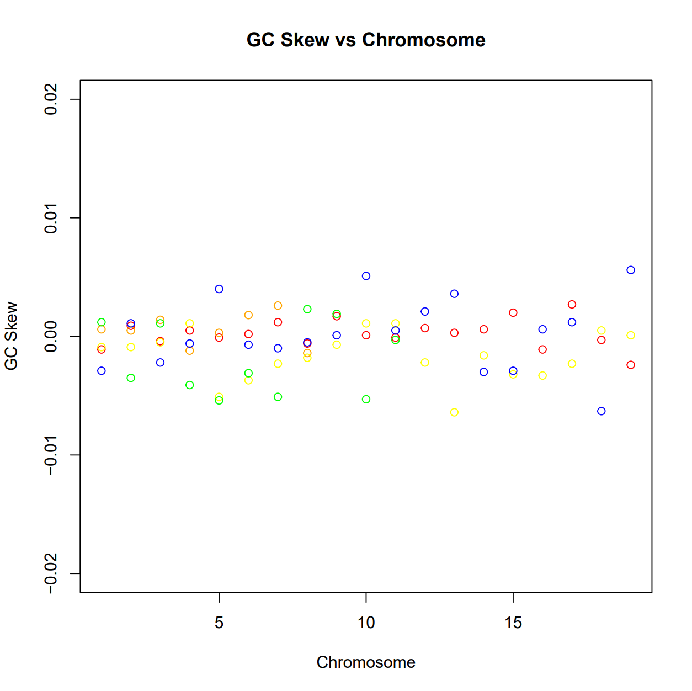
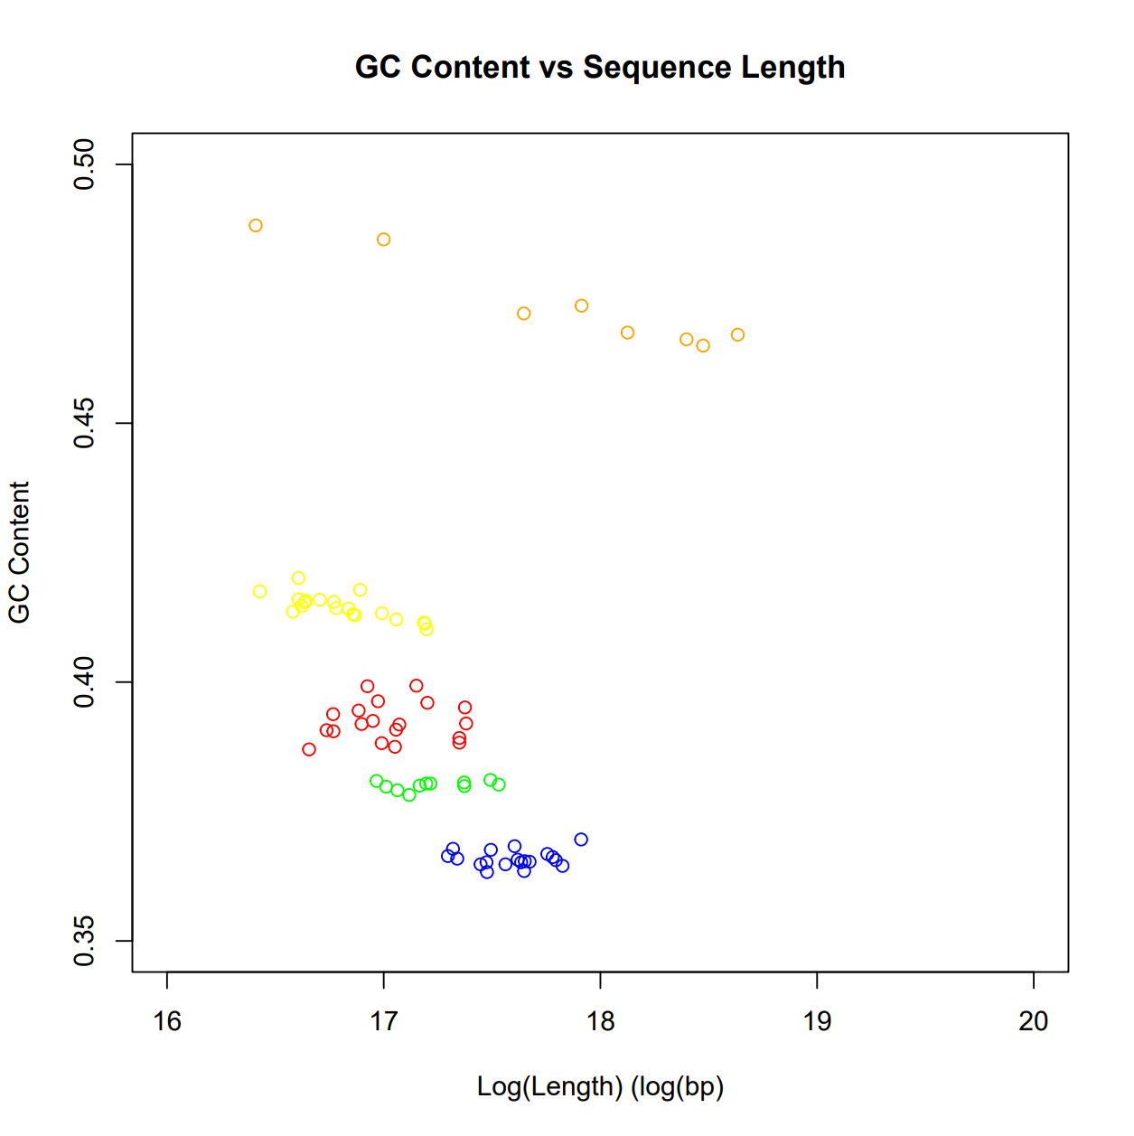
Bfl, Pma, Llo, Cmu, Mme

Slide 9
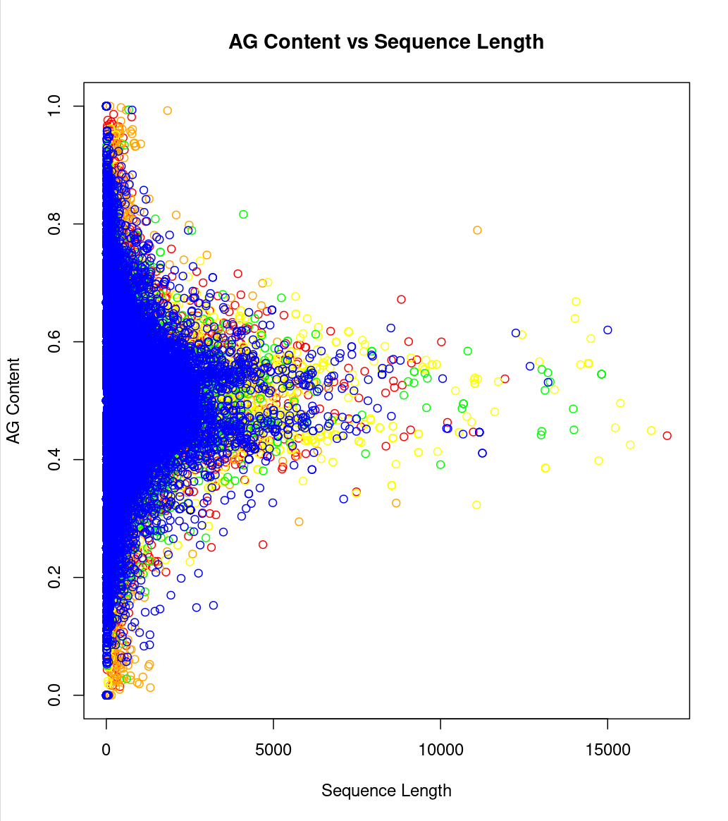
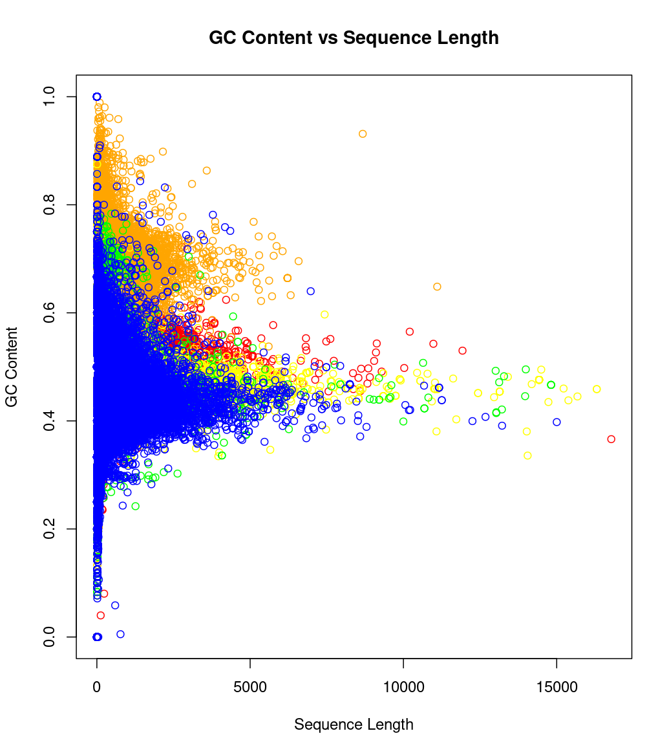
Bfl, Pma, Llo, Cmu, Mme
*Only CDS entries
Notes:
Frequency of GC file across entire genome, then plot annotations on it
Chromatin
Gc3
Codon bias

Slide 10
Overview of Work:

Slide 11
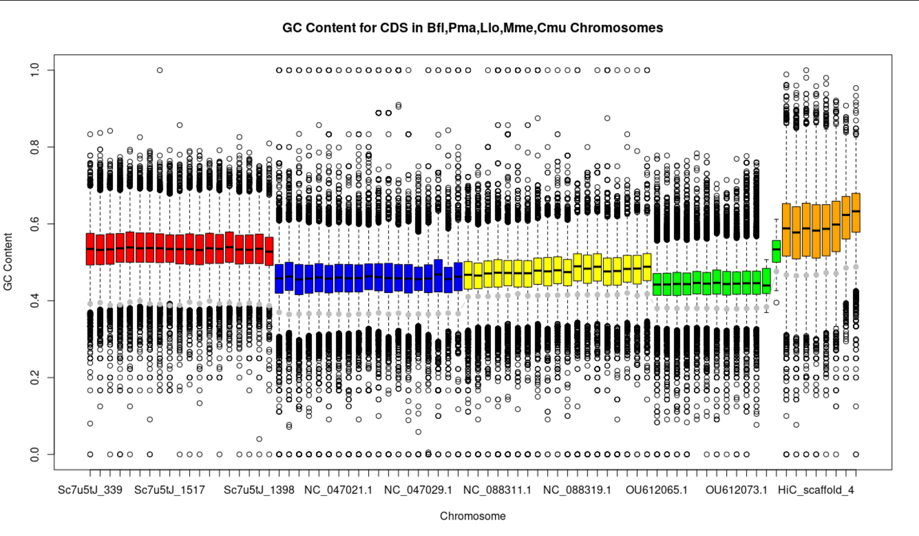
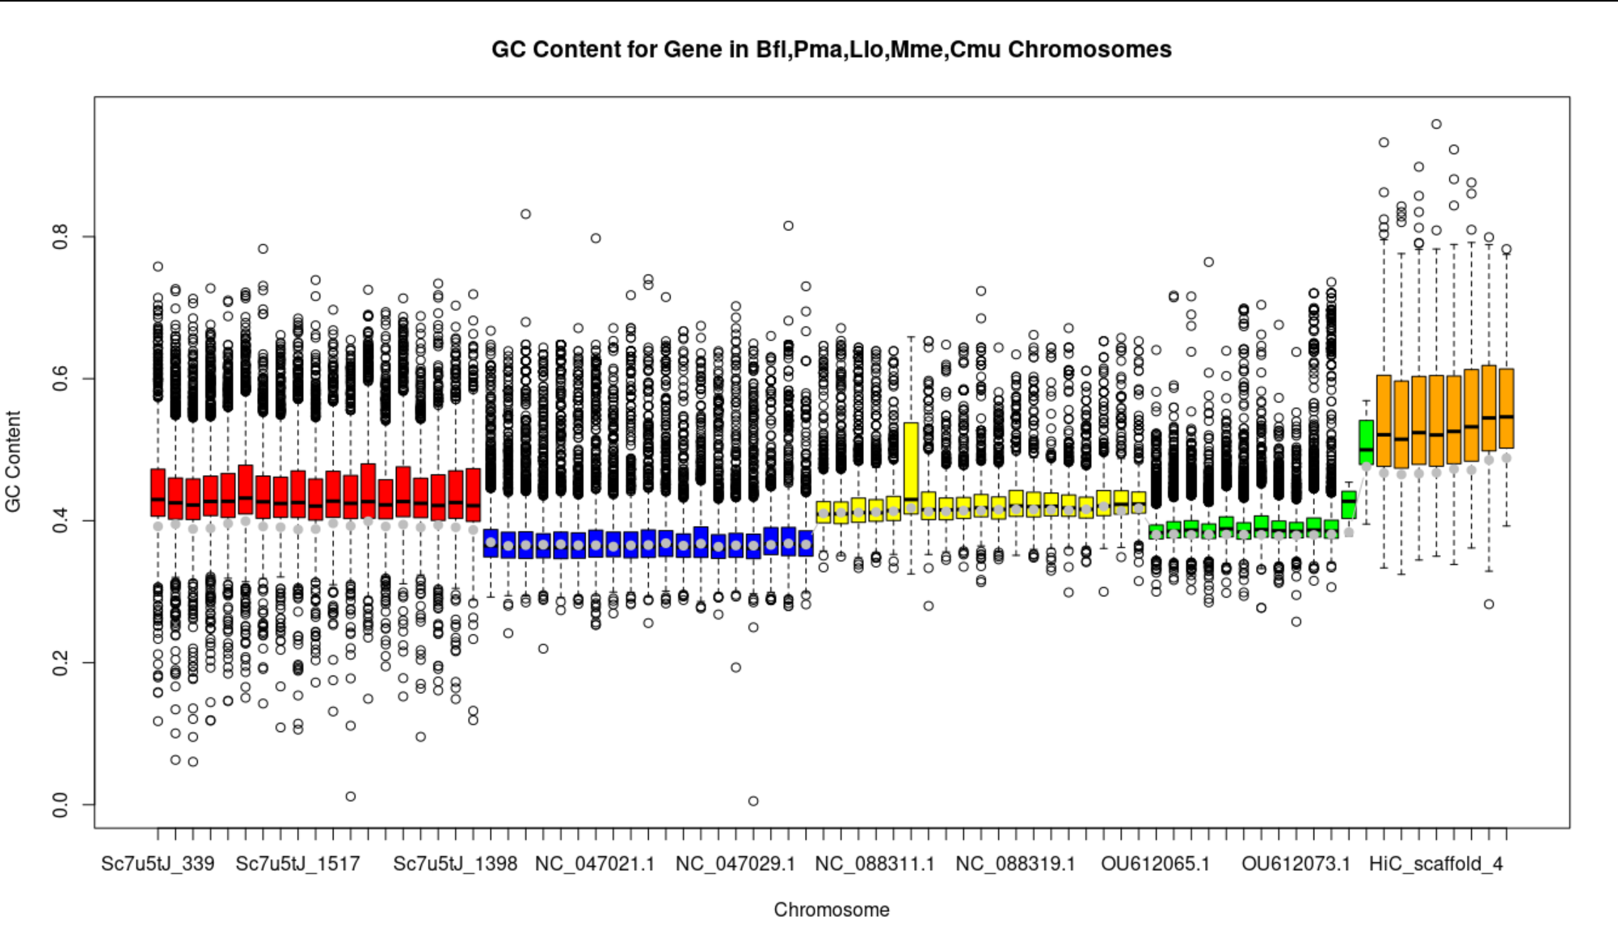
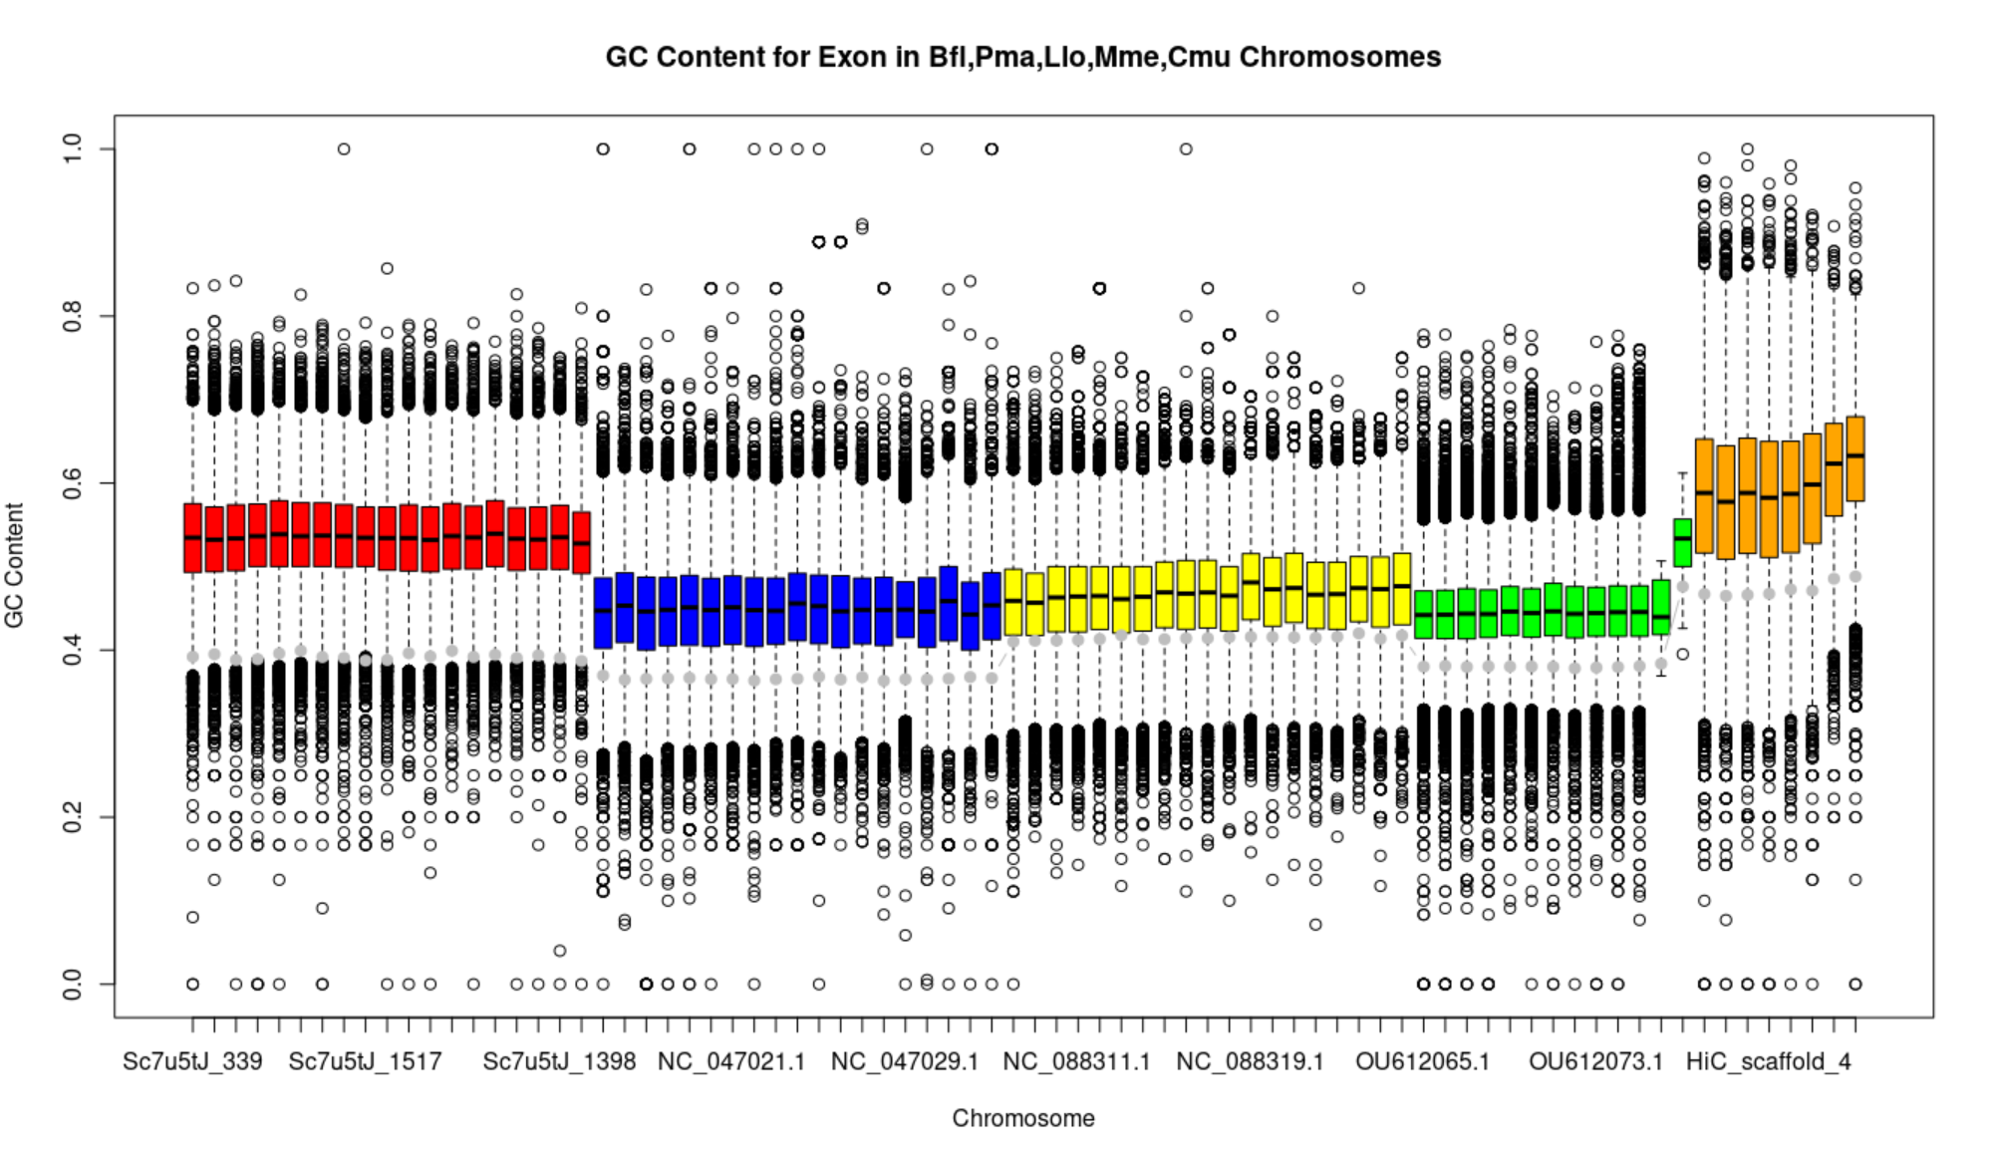

Slide 12
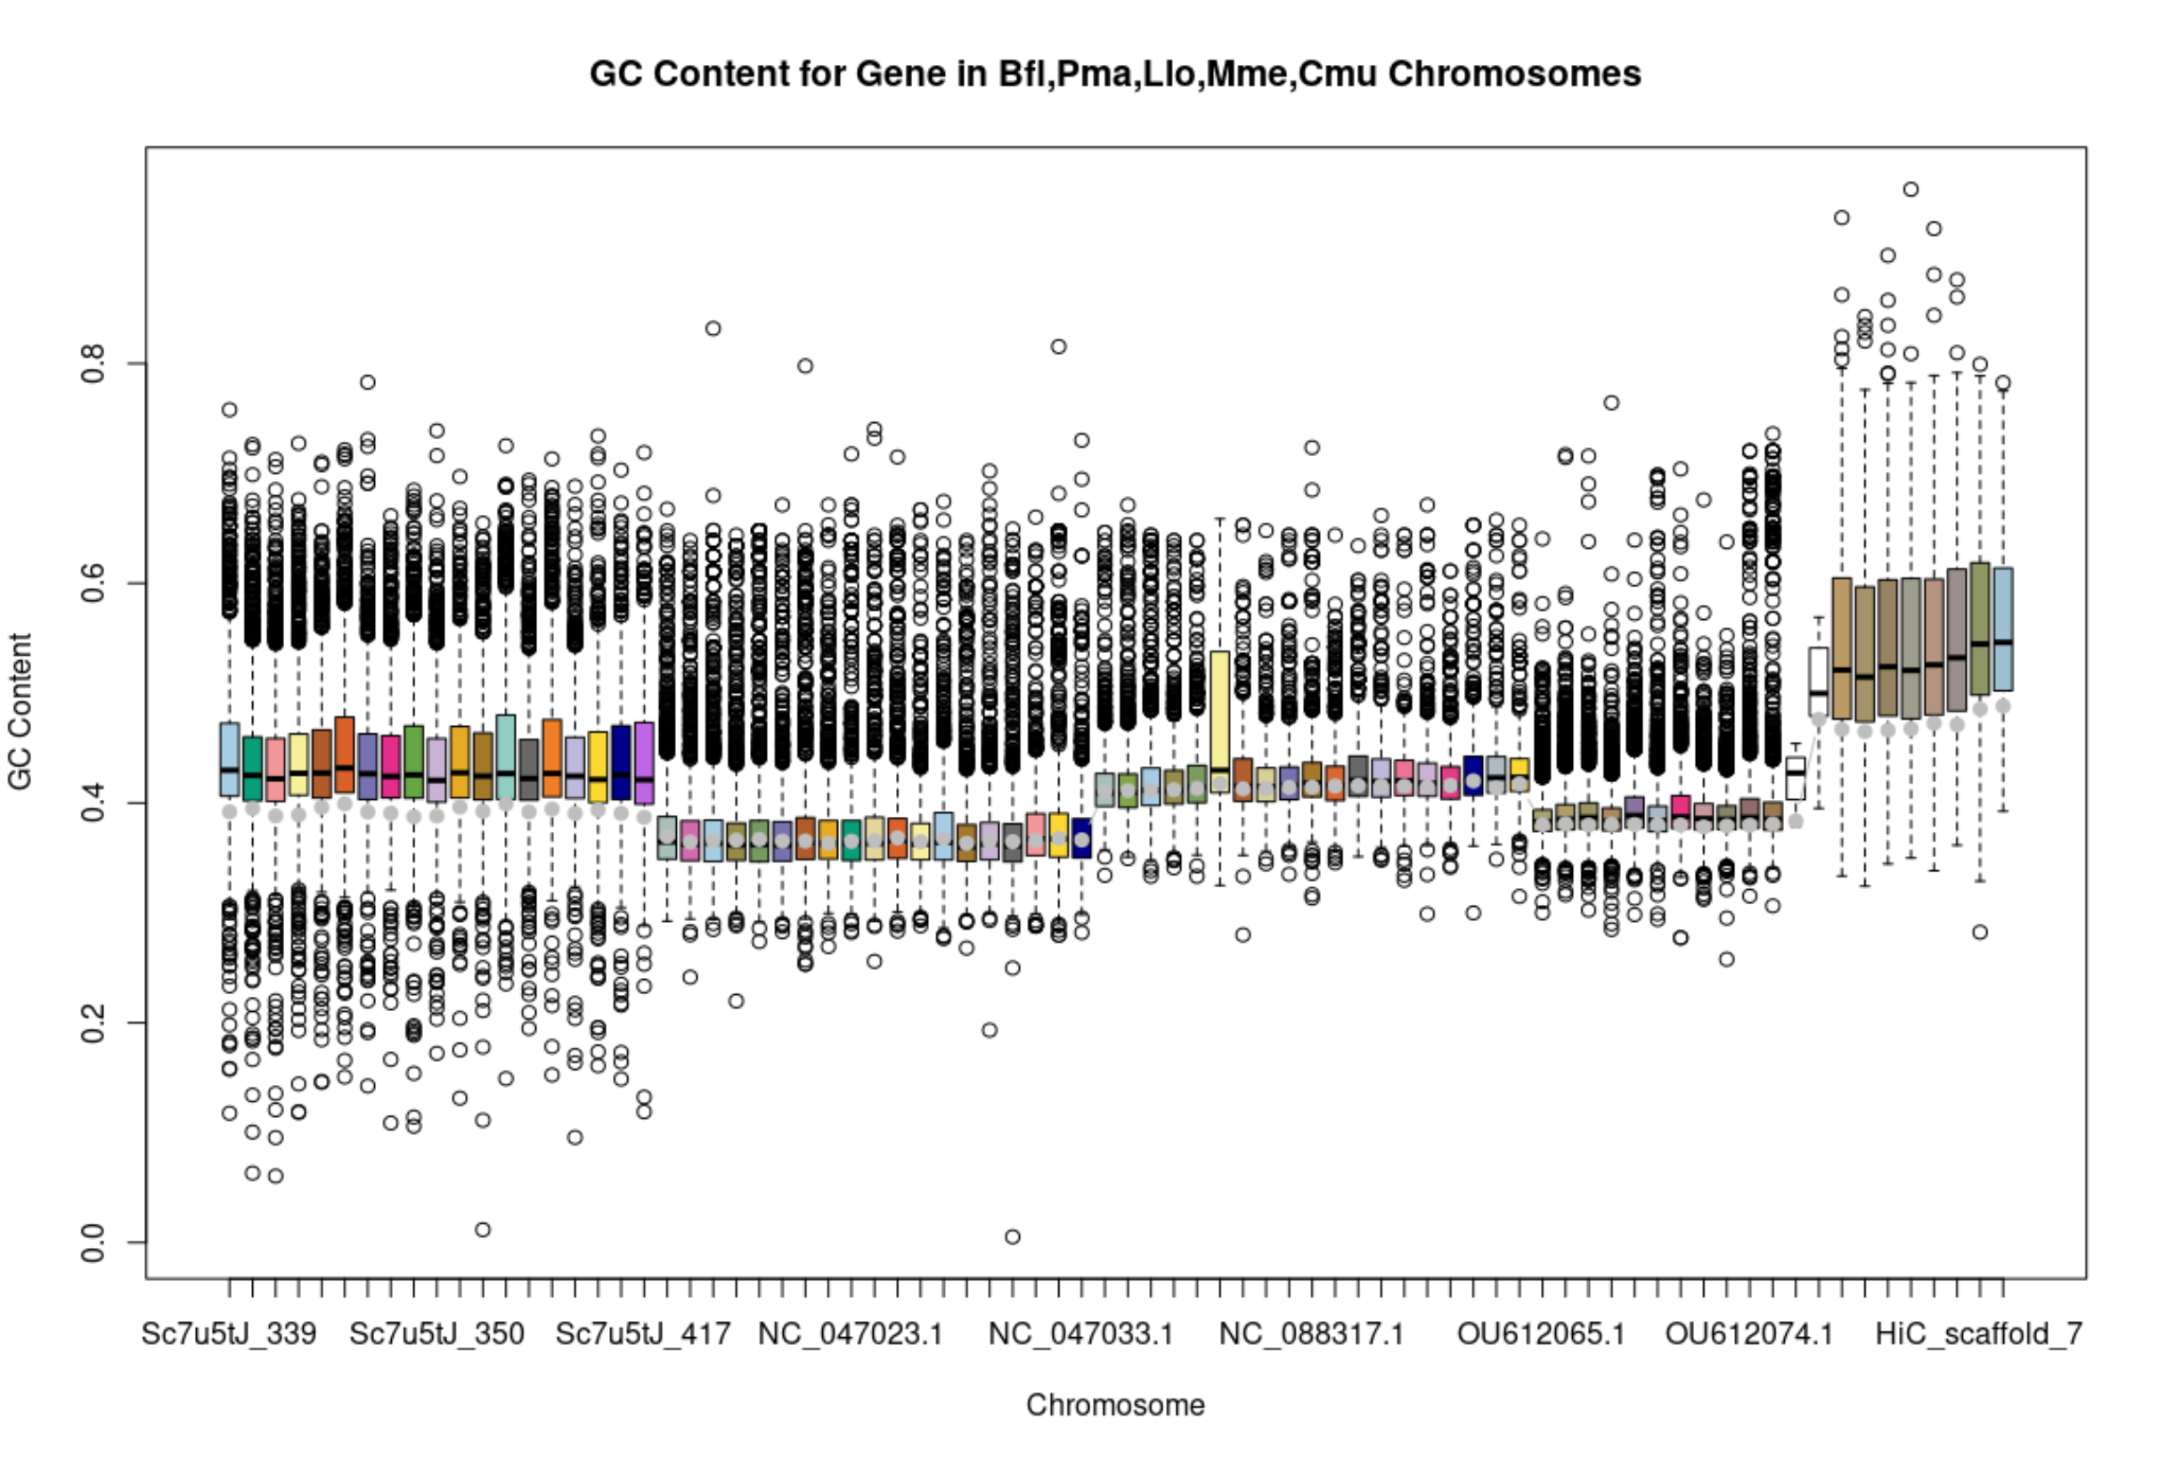
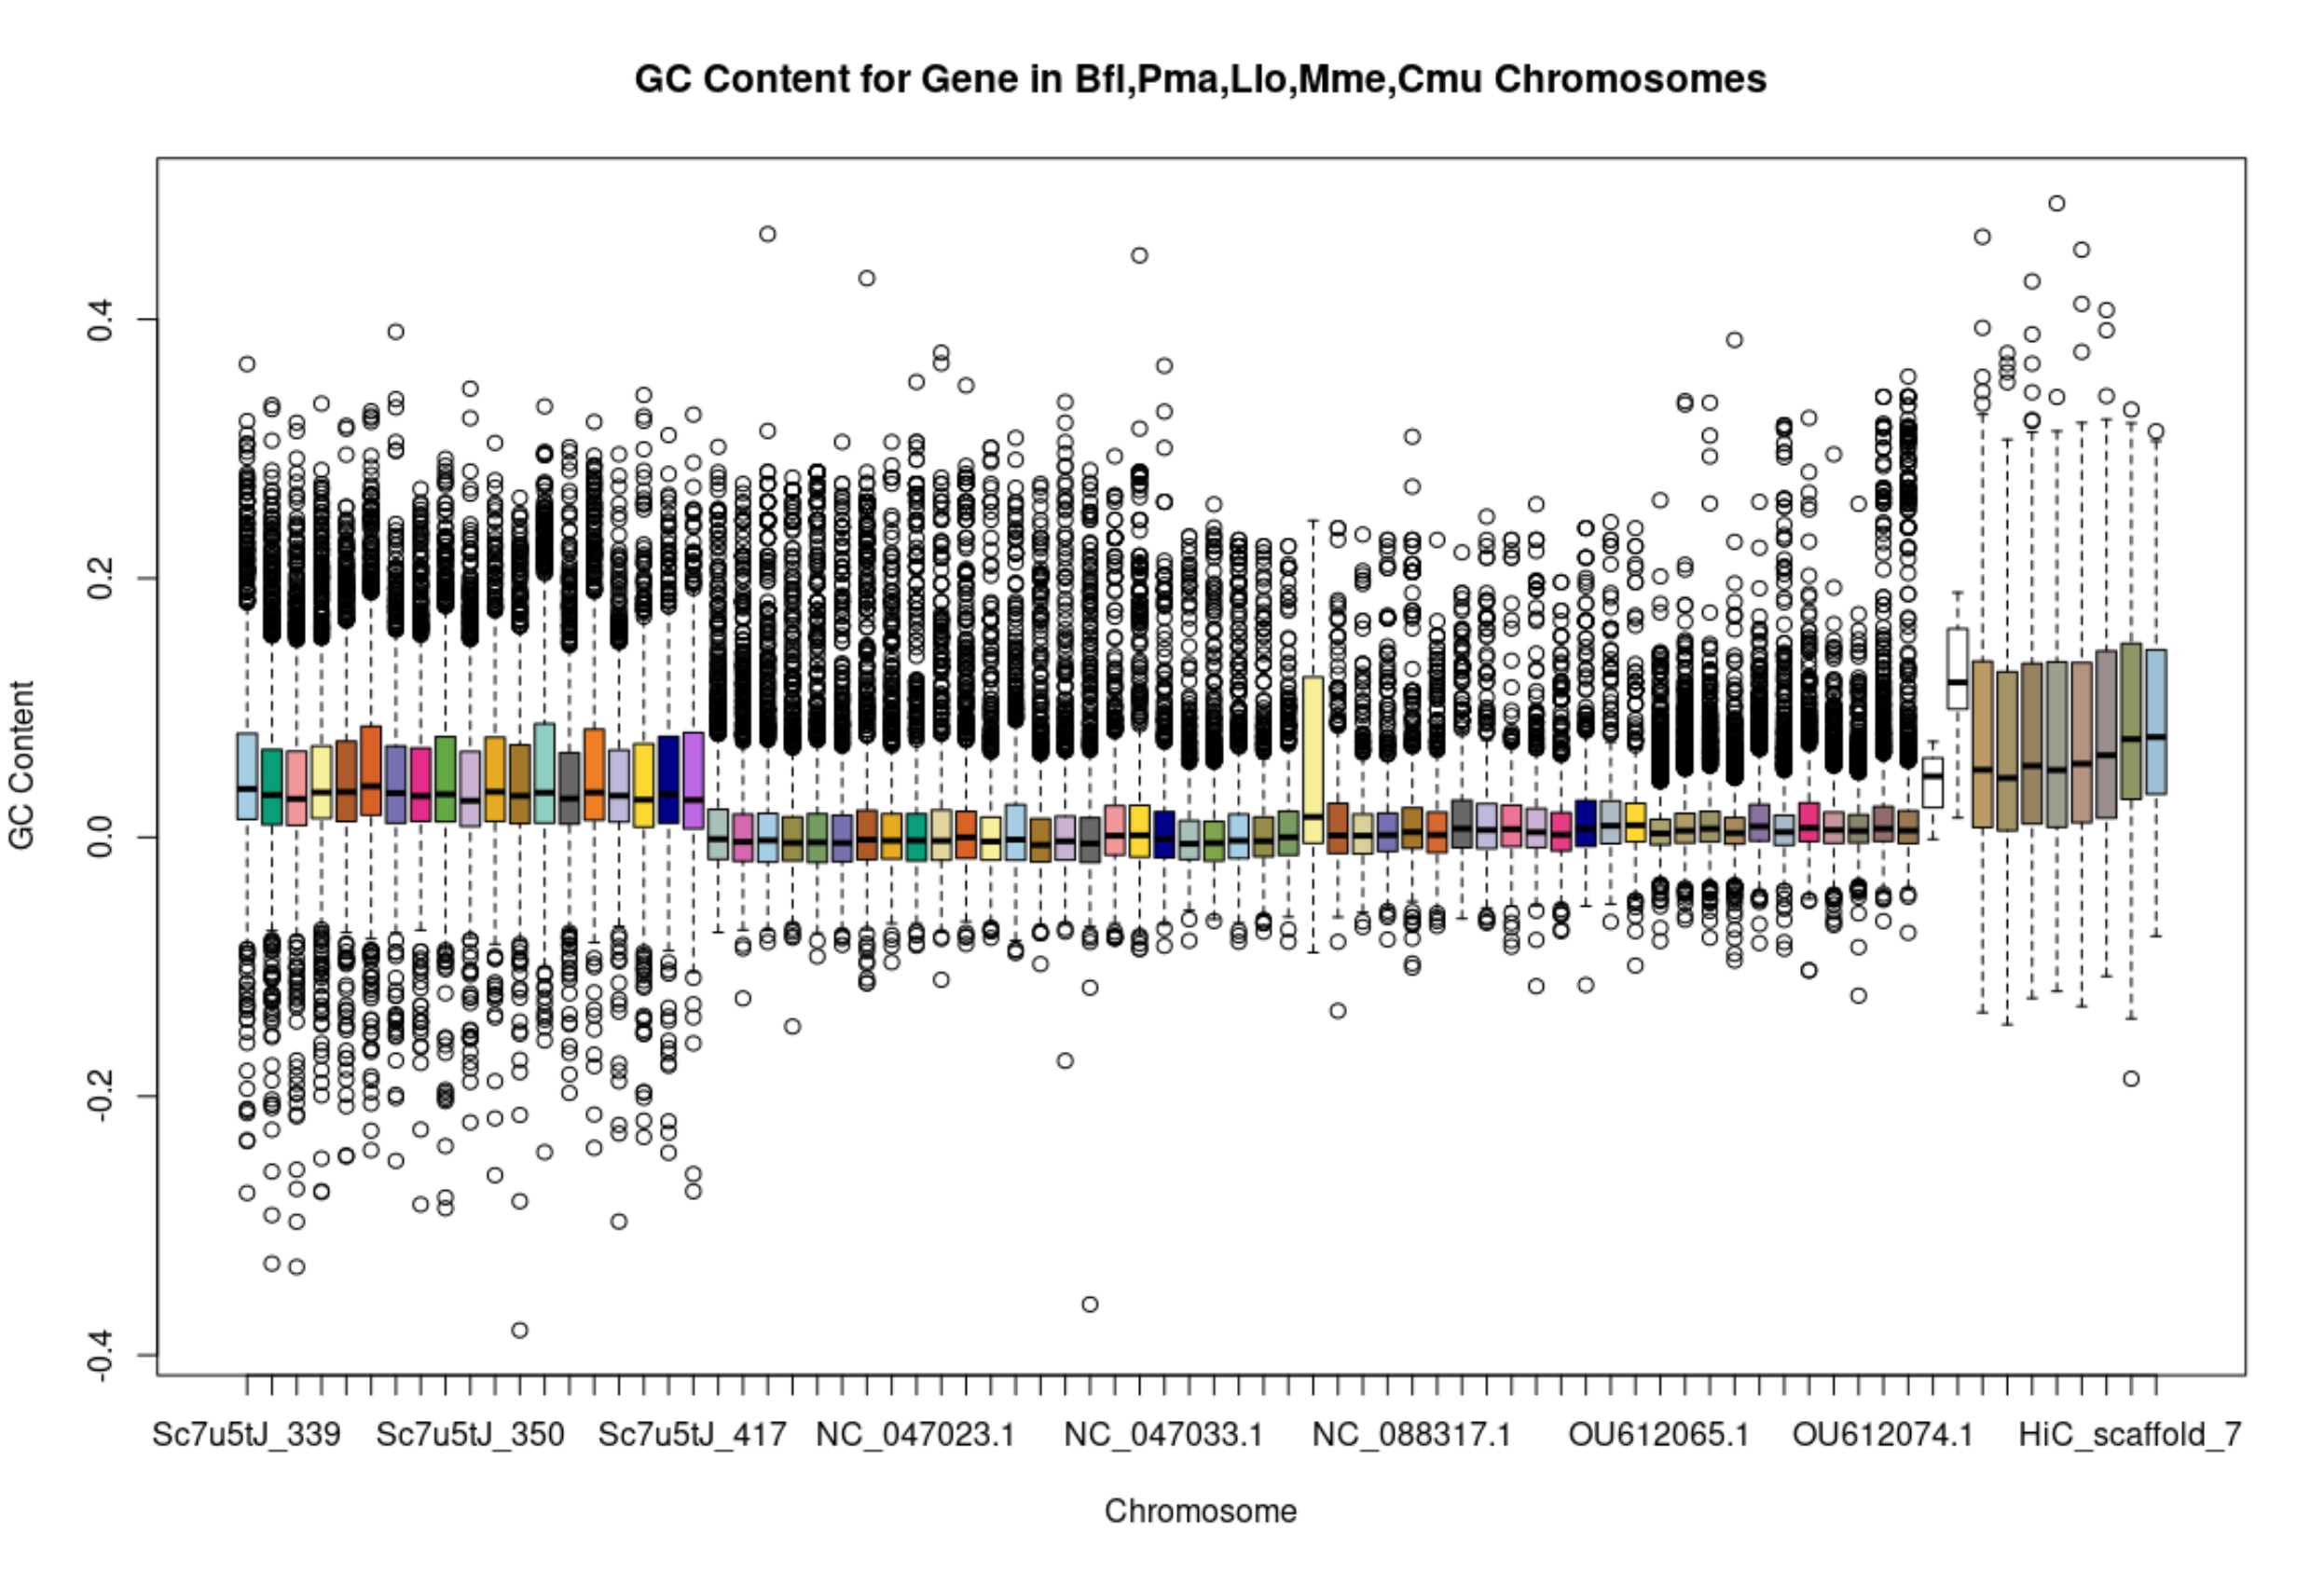
Alg Tracing
Averaged the color of all the single copy orthologues in the chromosome
Top: Plotted chromosome average as grey line
Bottom: Shifted each chromosome by avg GC content of species

Slide 13
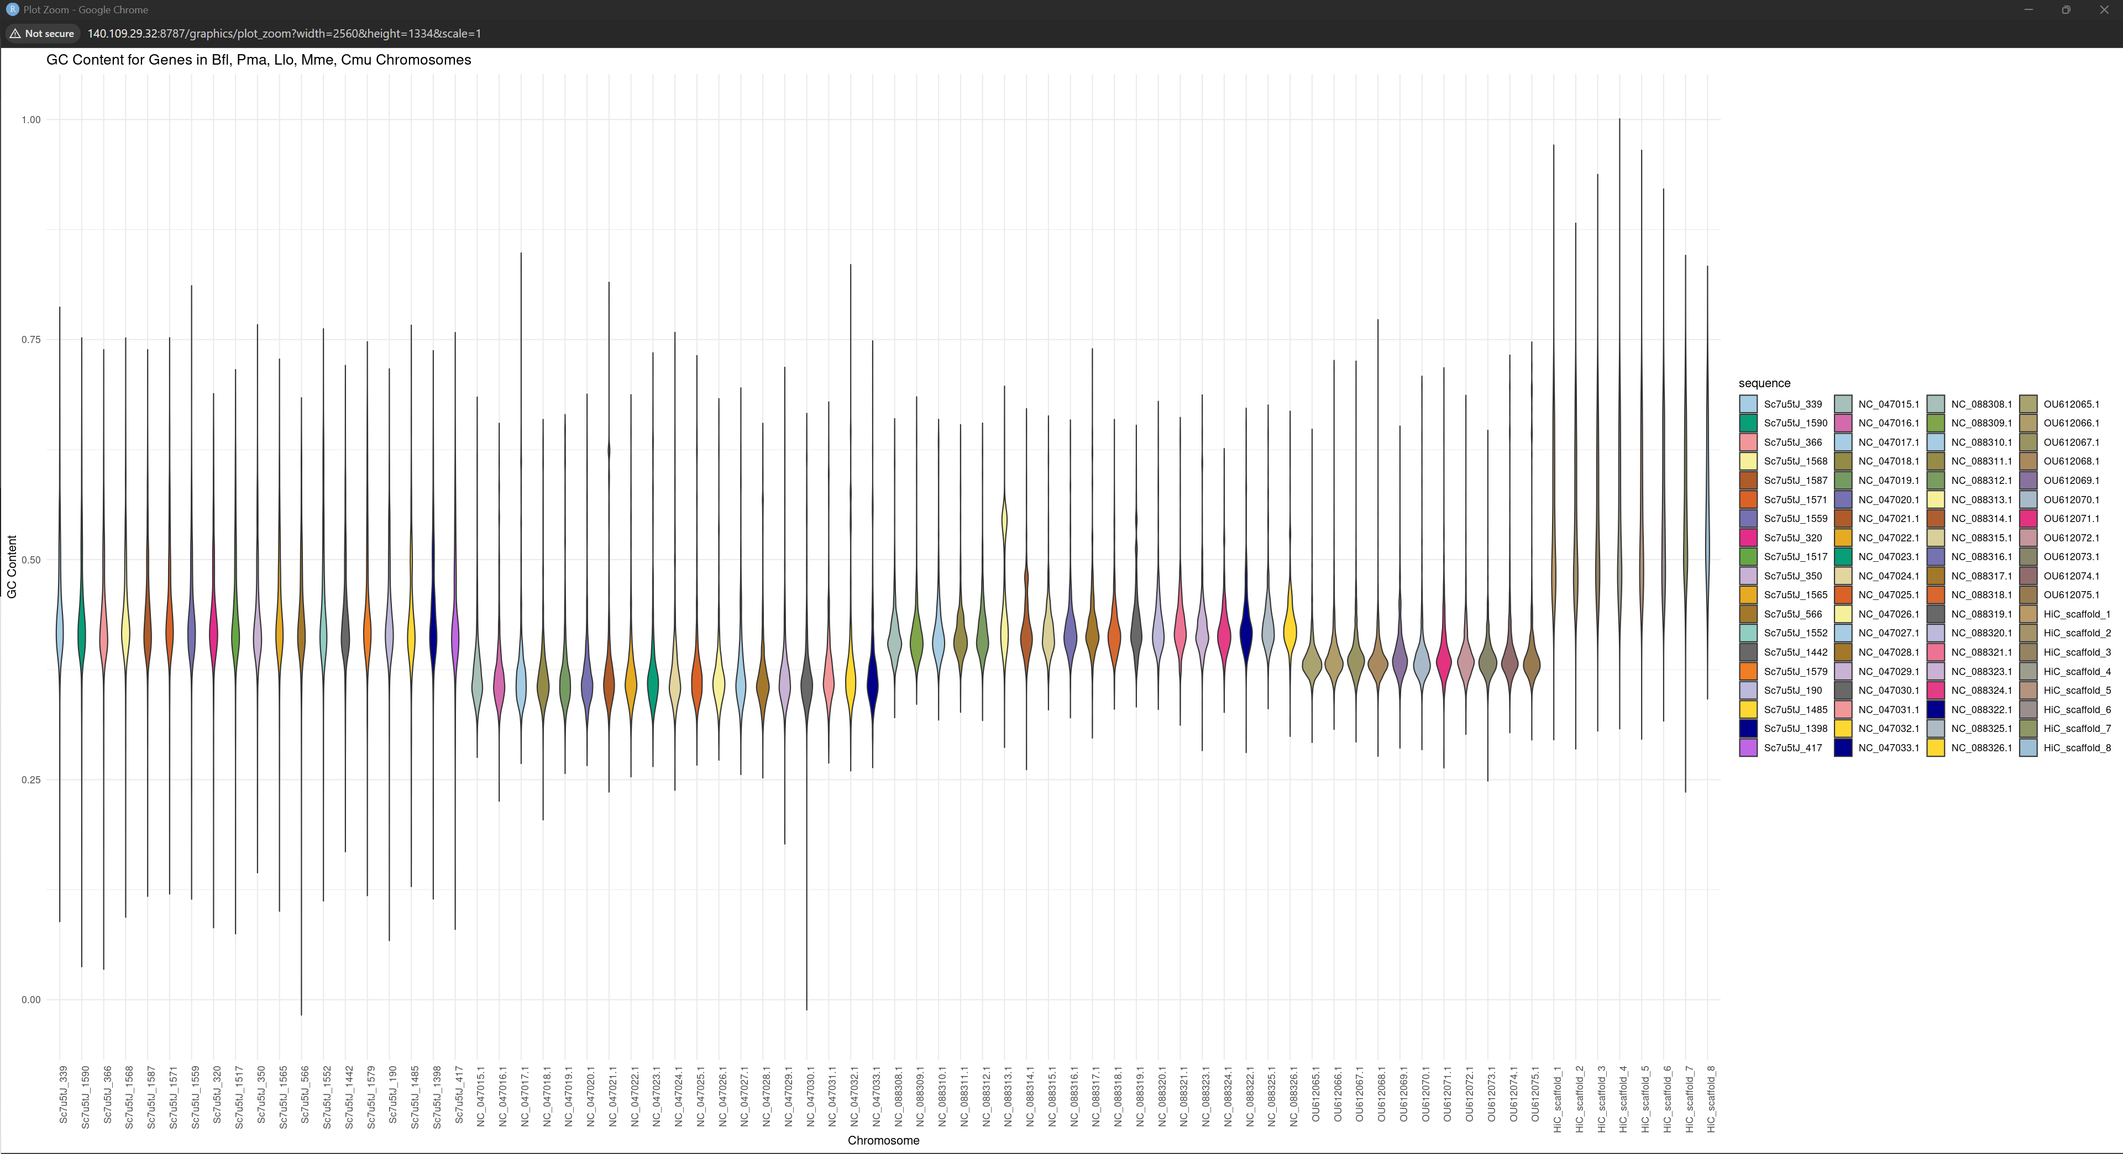
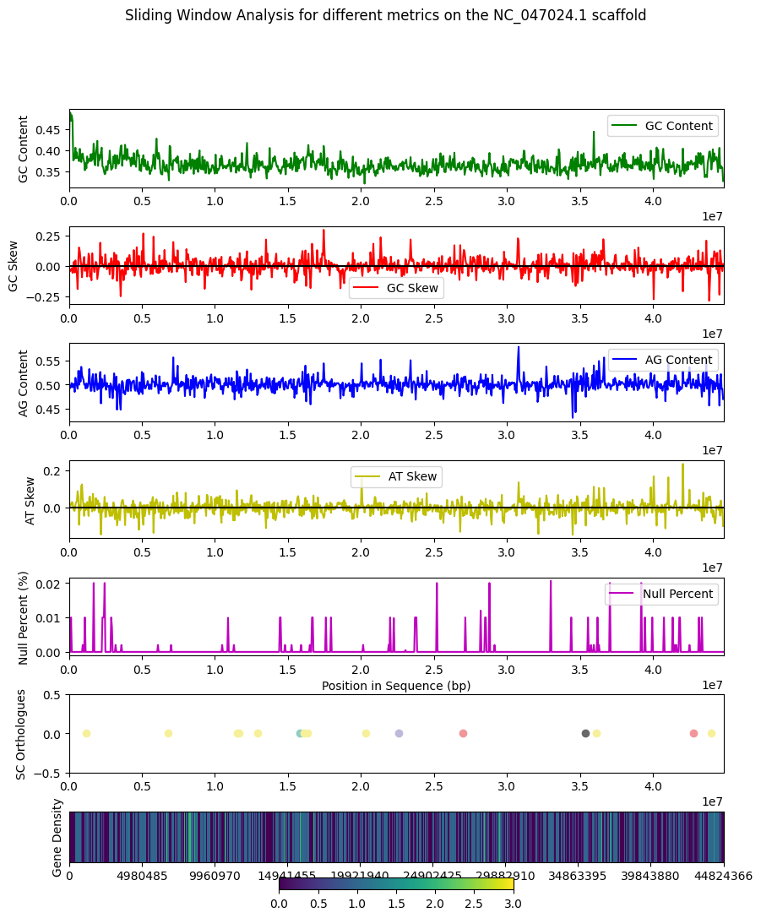
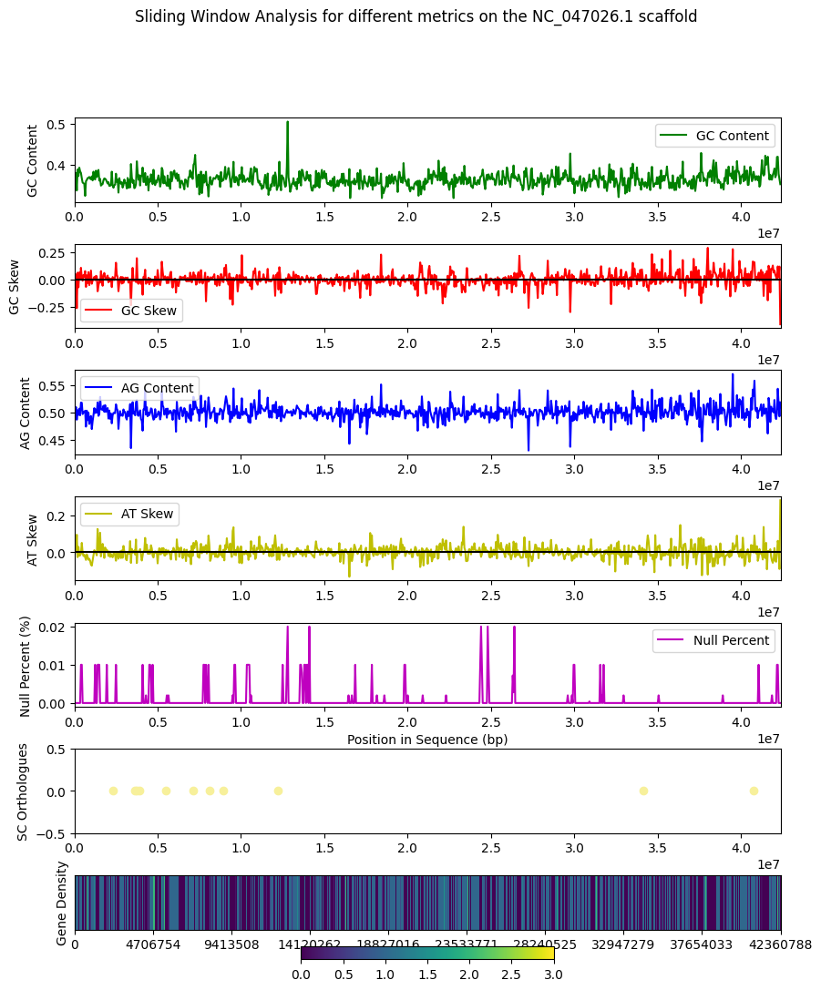
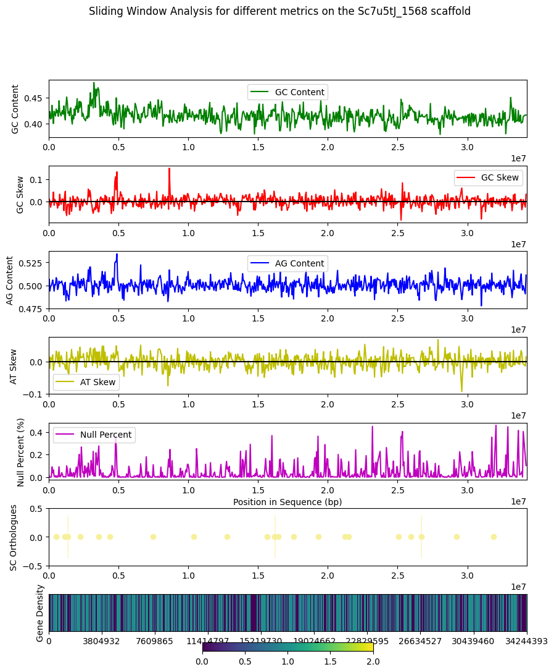
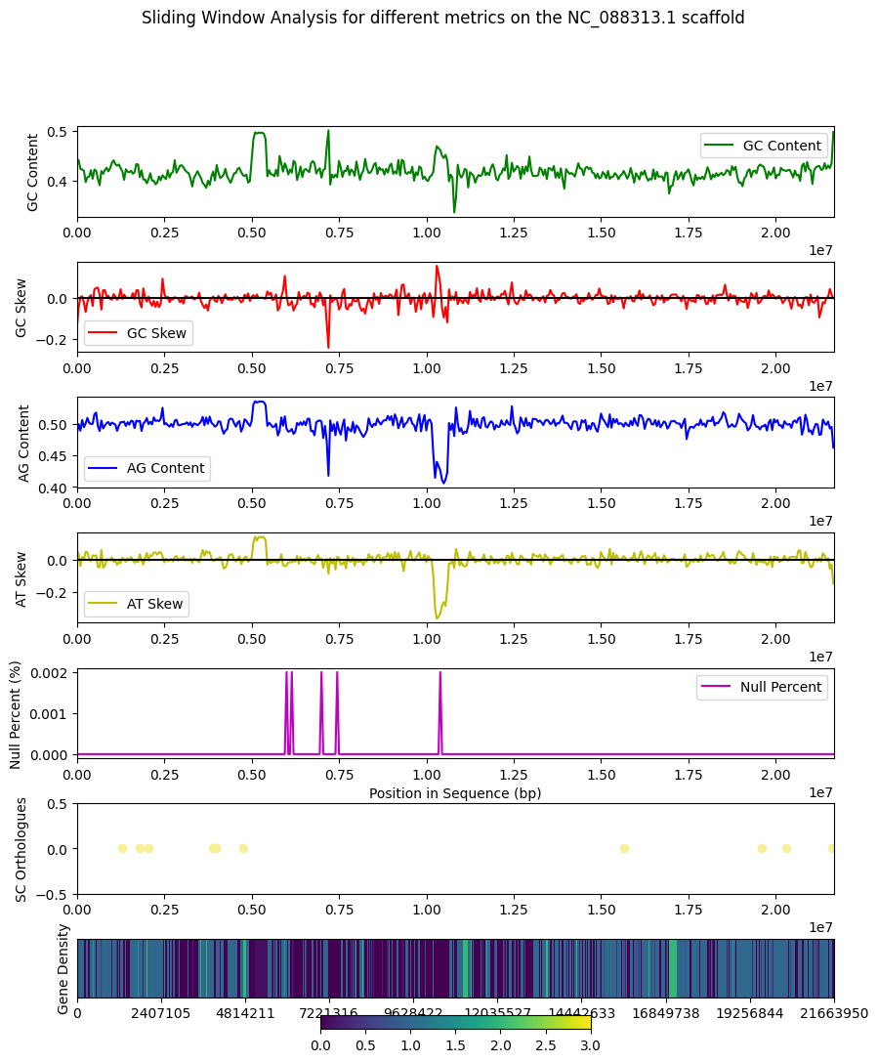
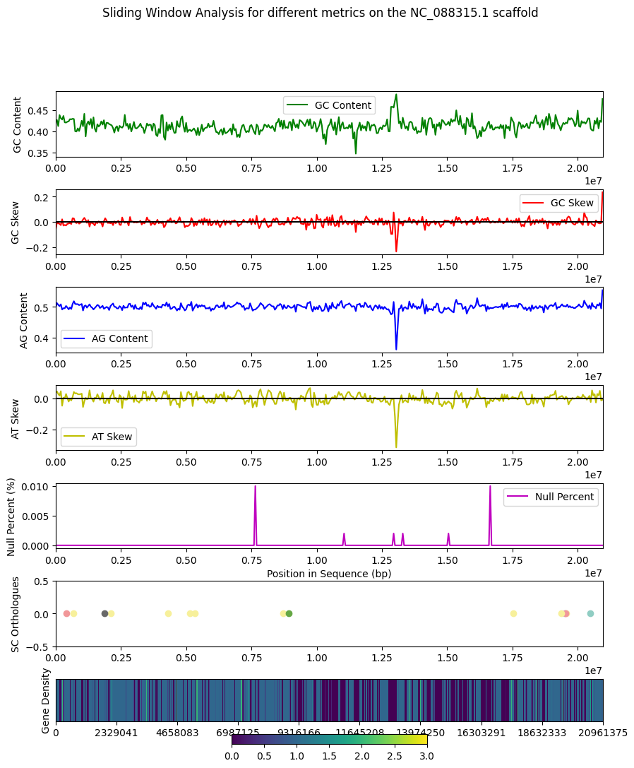
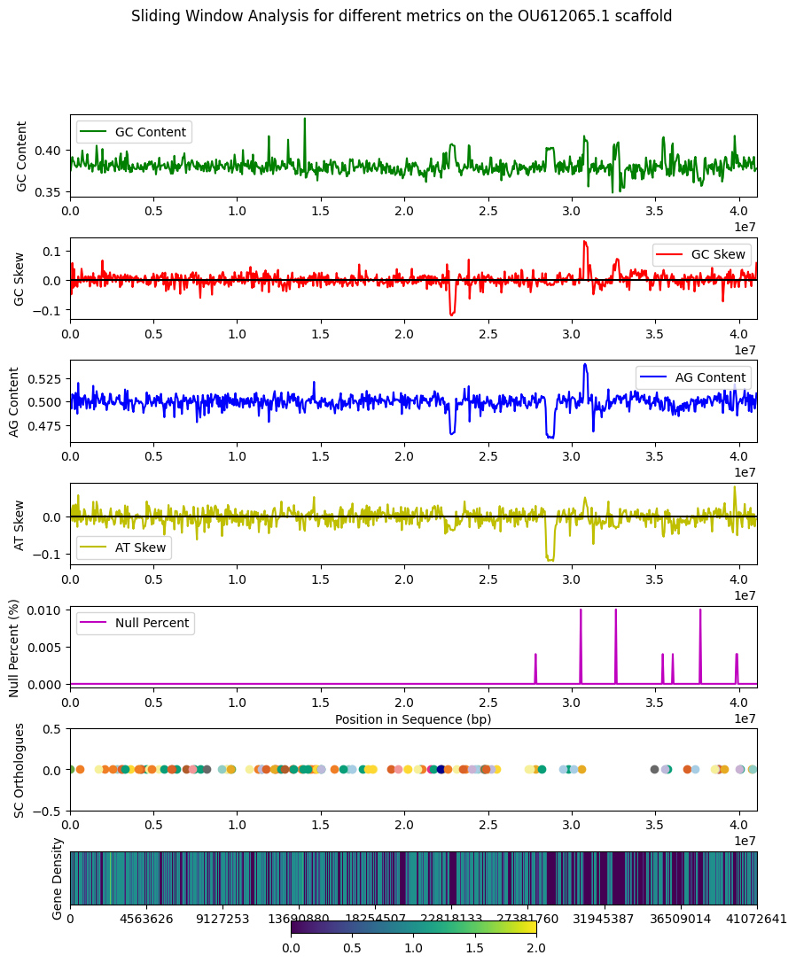

Slide 14
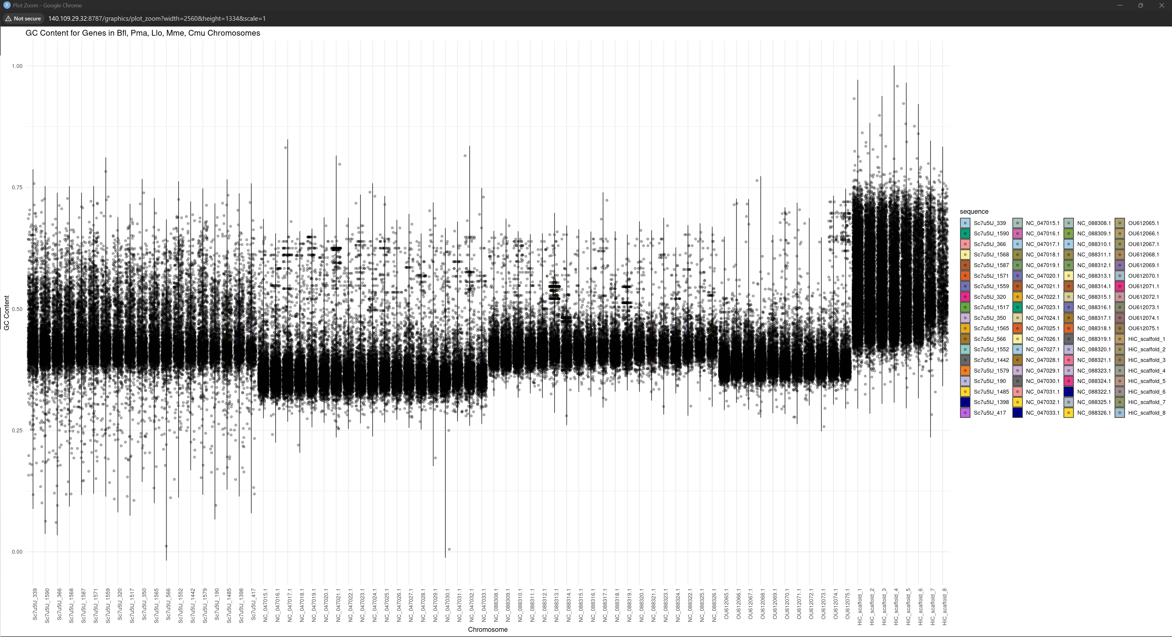

Slide 15
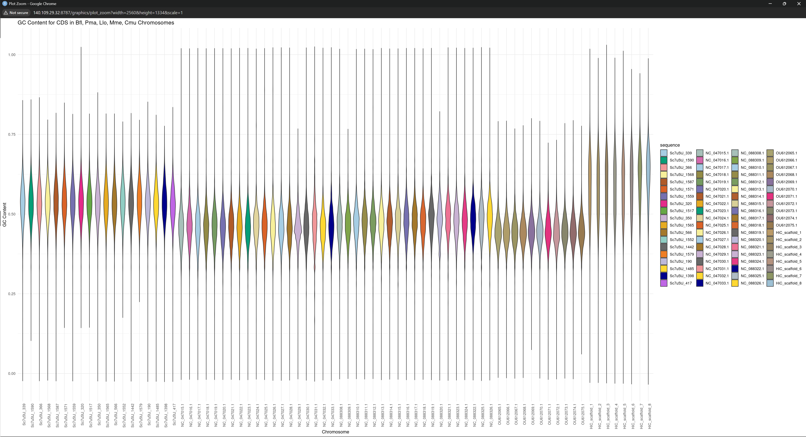

Slide 16
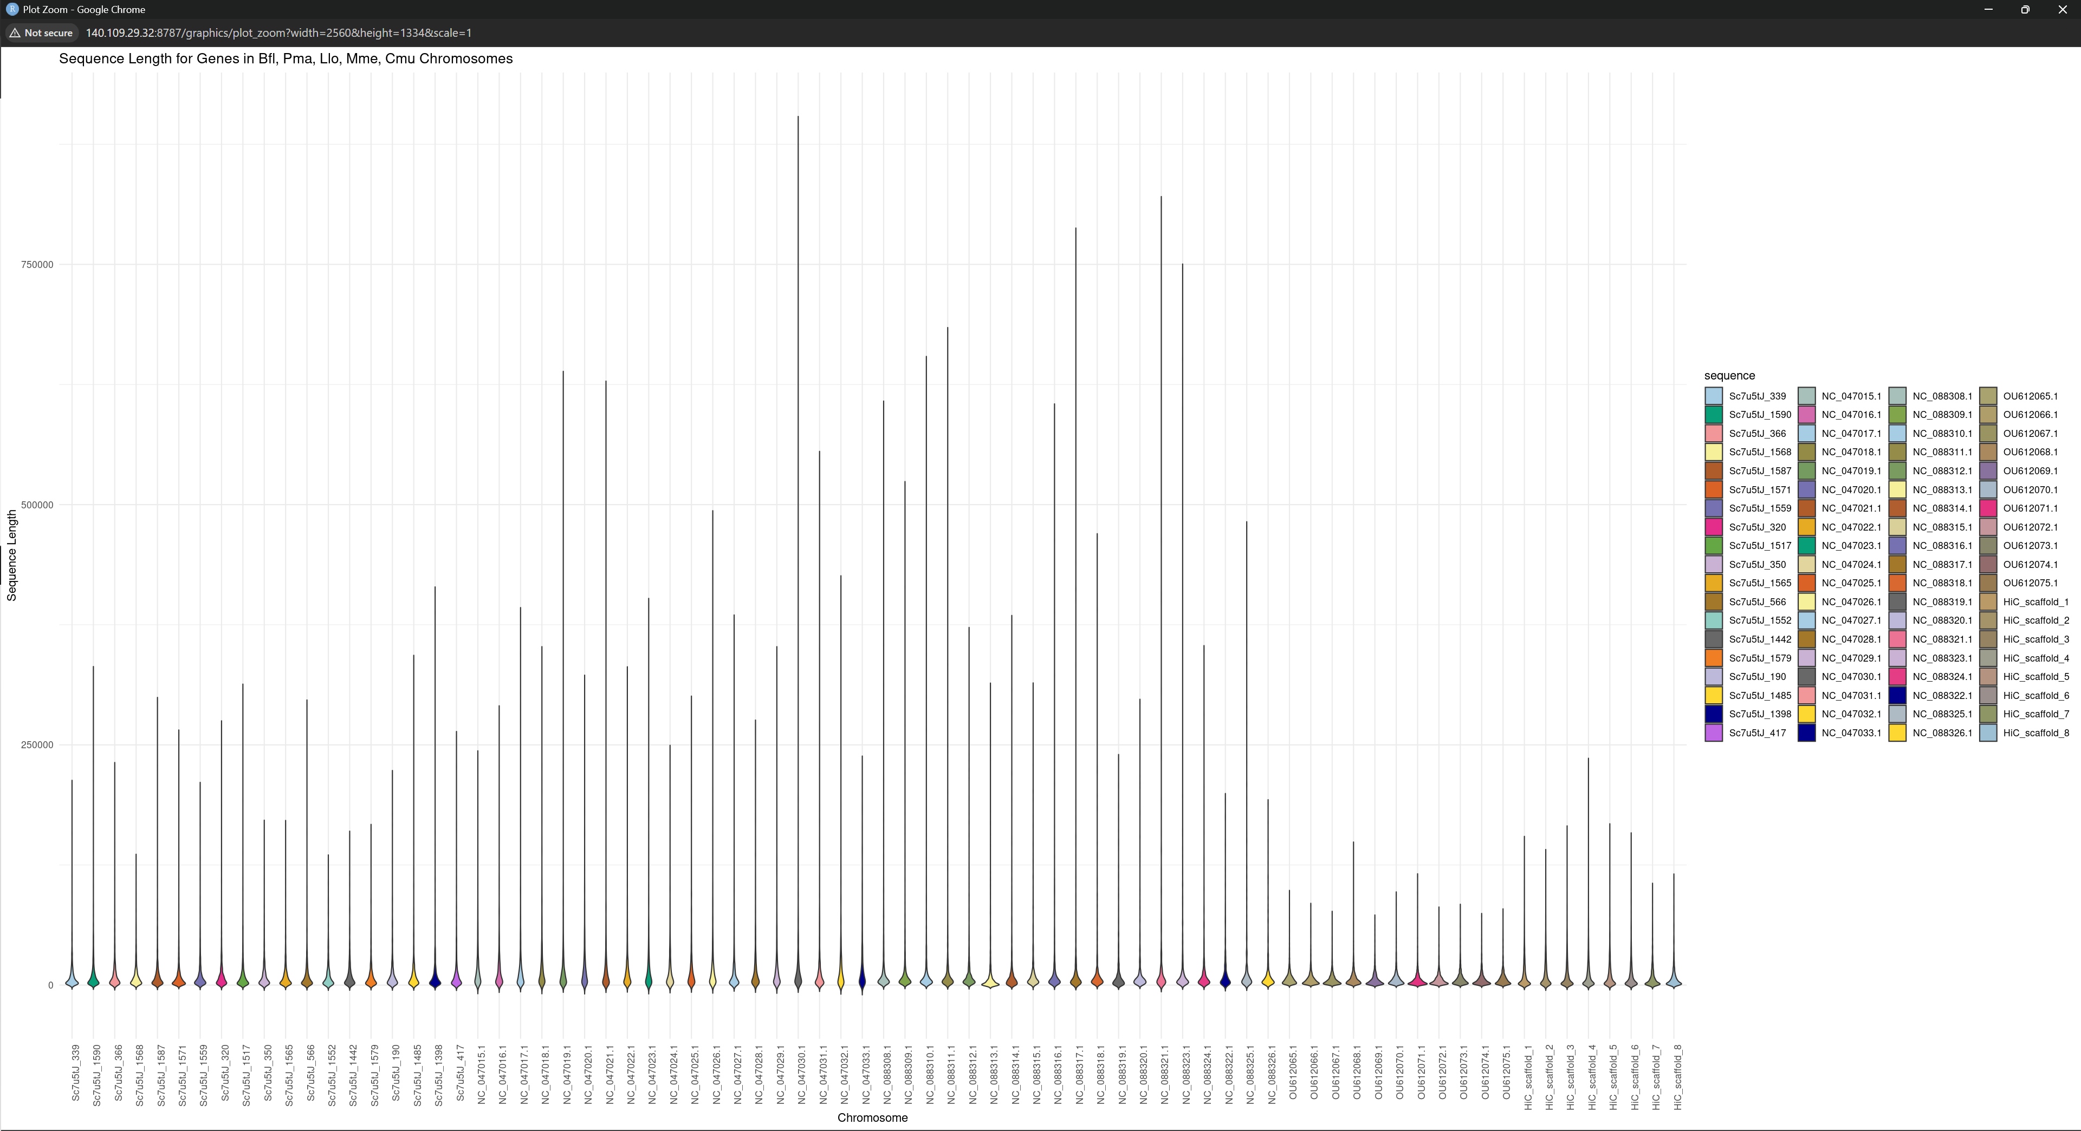

Slide 17
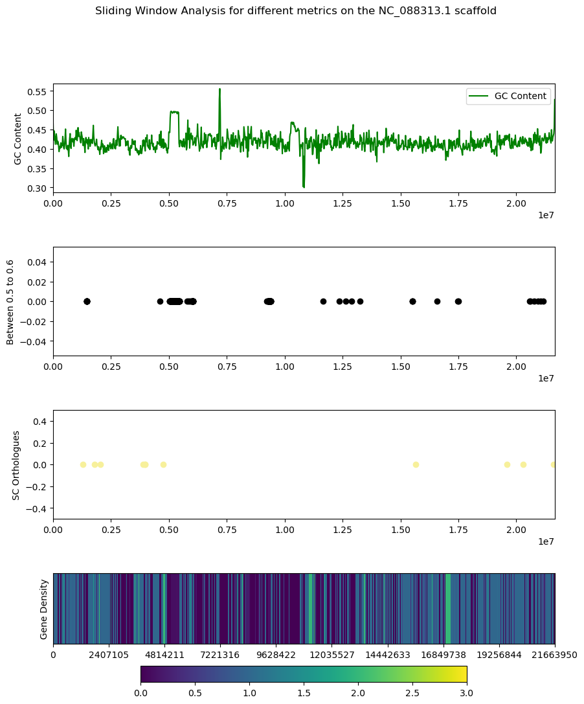
Llo Biomodal Distribution
High GC genes cluster
Could be due to large centromeres

Slide 18
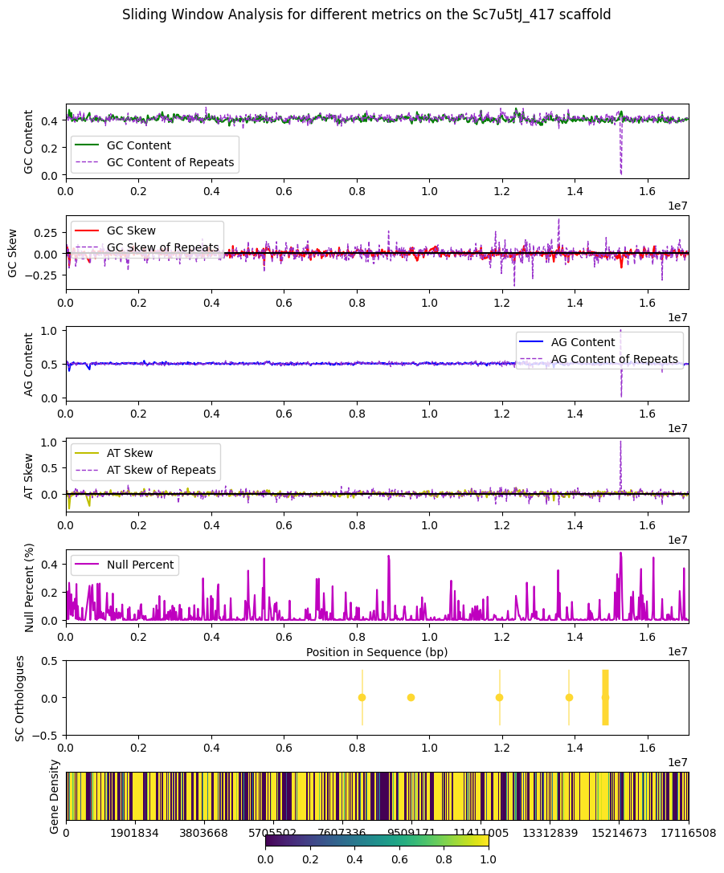
Sliding Window Comparison of Repeats
Repeat content is much more extreme

Slide 19
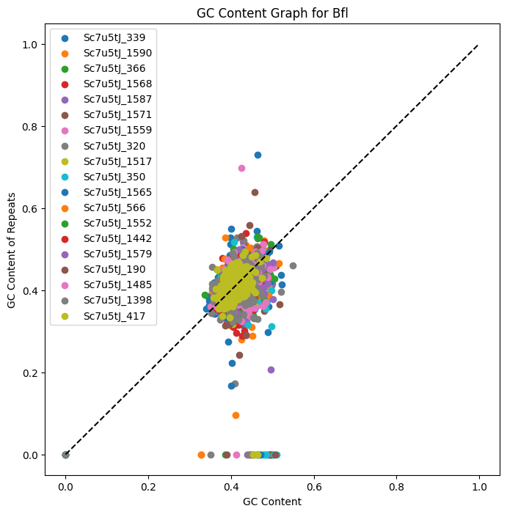
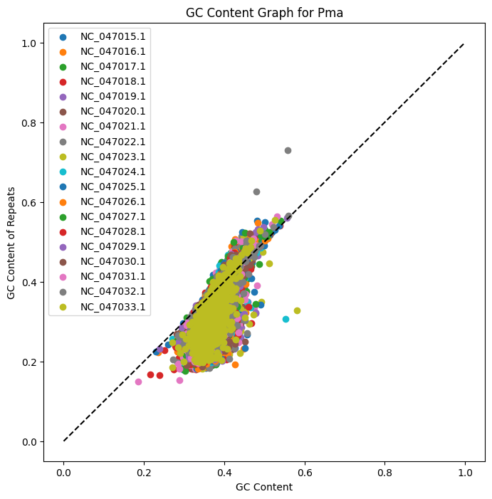
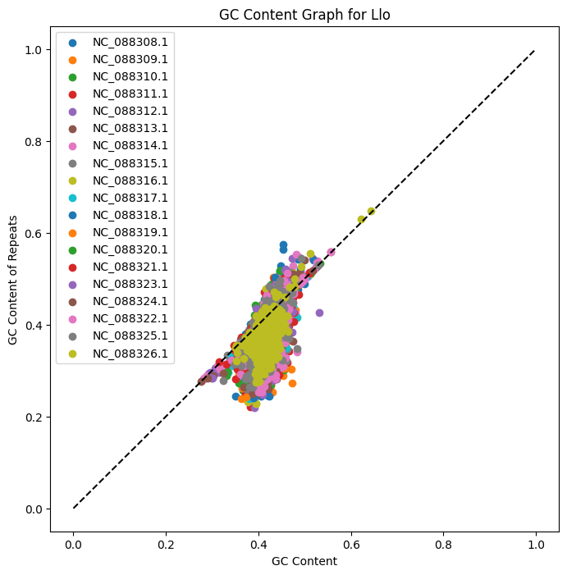
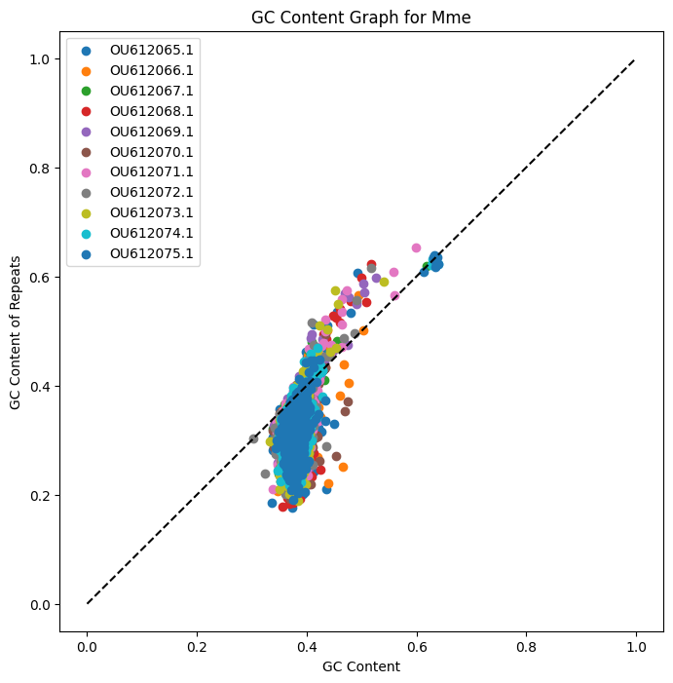
Effects of Repeats
Weak positive correlation between GC content of window and GC content of repeats in window

Slide 20
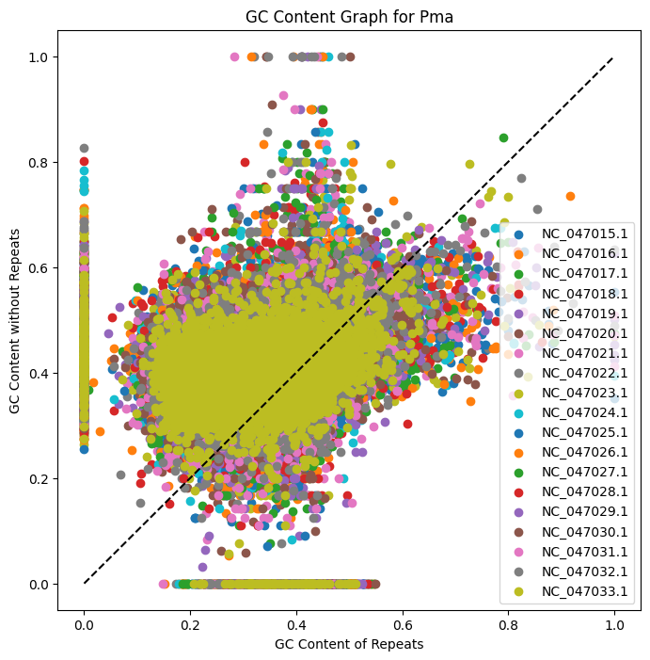
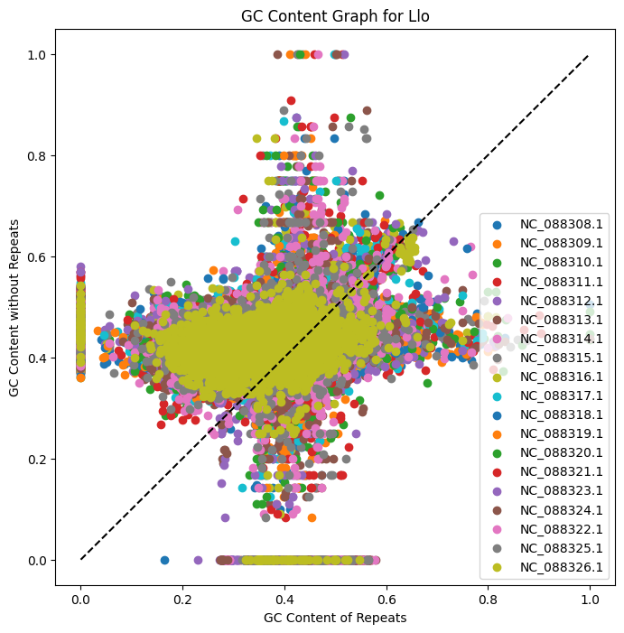
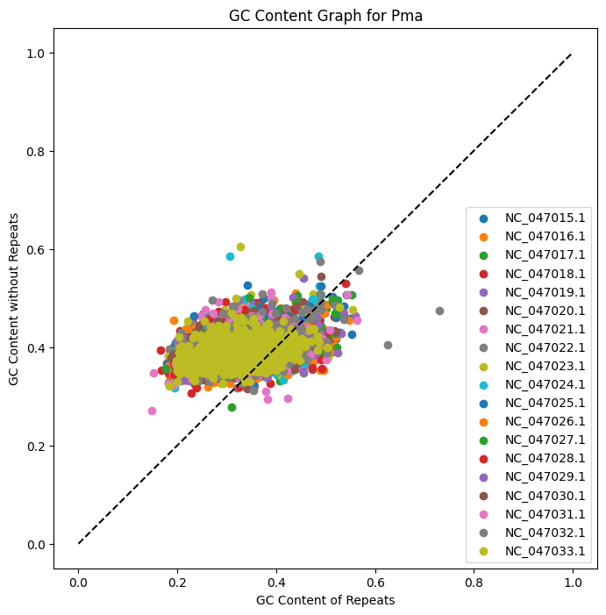
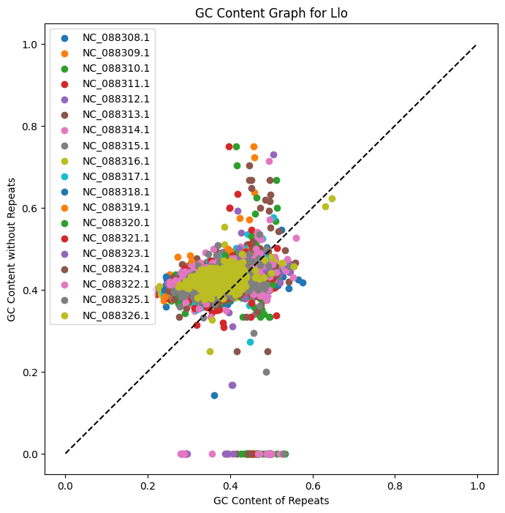
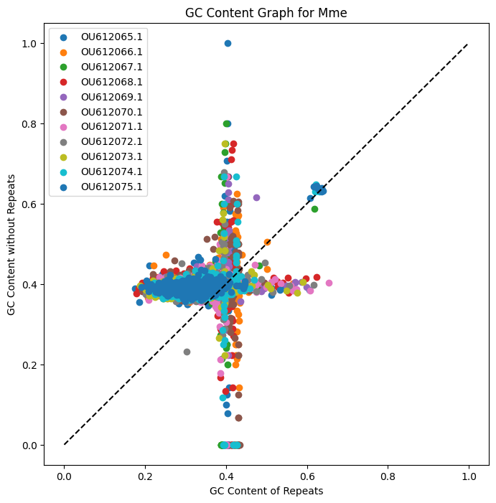
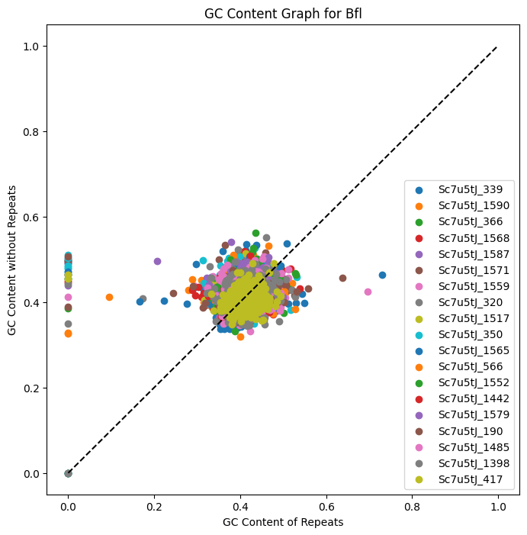
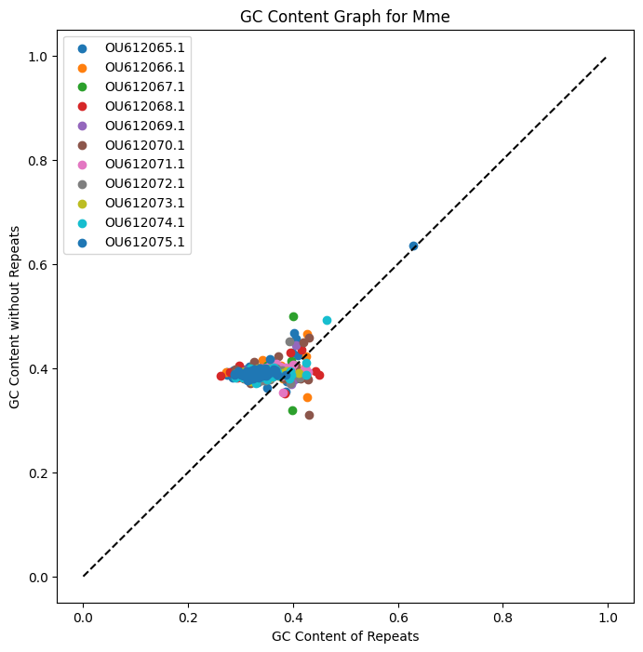
NR v. R
No correlation
When window size is too small, crosses appear -> sections of high variance due to small length, while large length has low variance
Notes:
Maybe Mme has longer sections of repeats? -> 20000b to 200000b
Try to reproduce -> 20000b to 2000

Slide 21
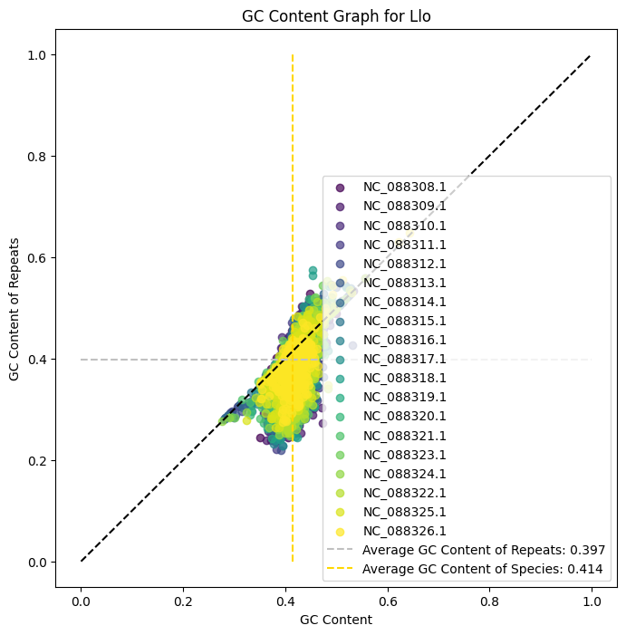
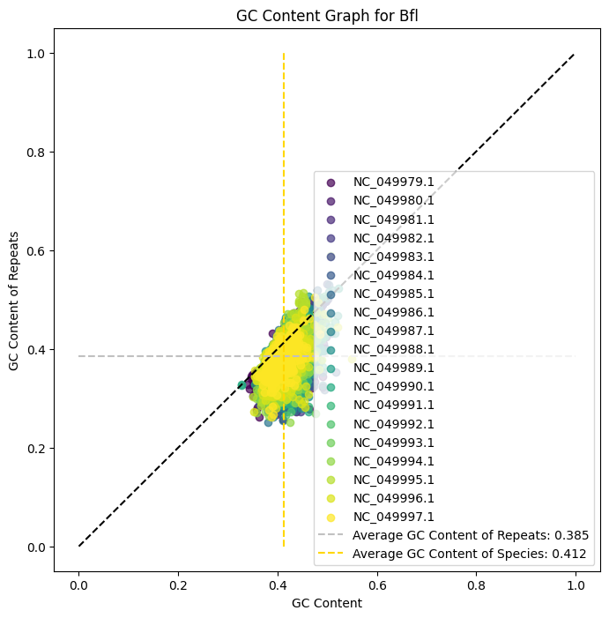
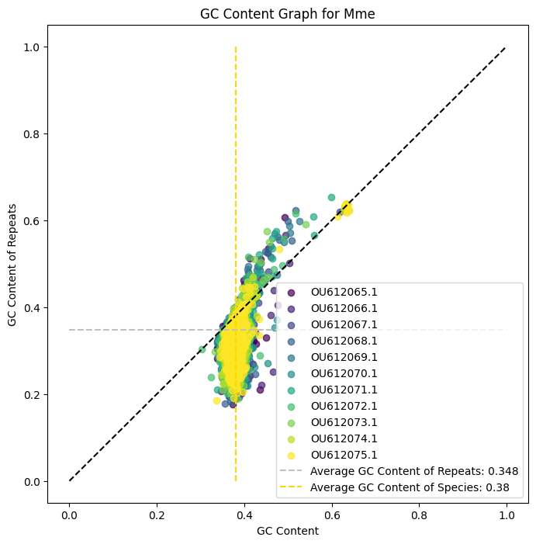
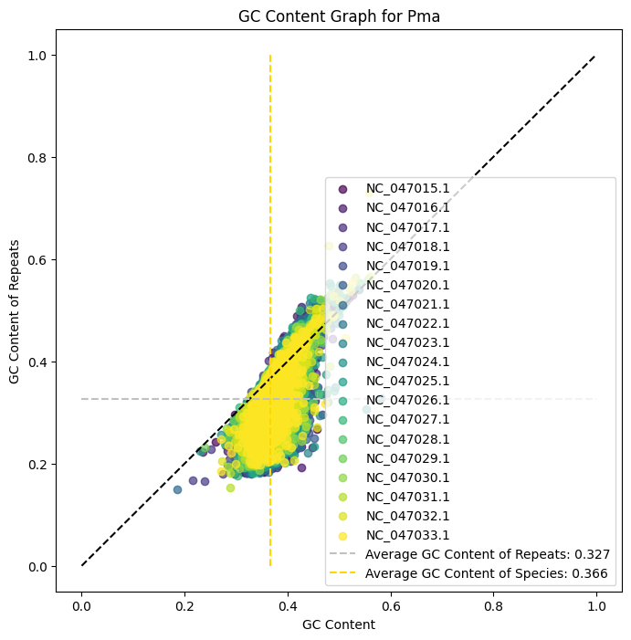
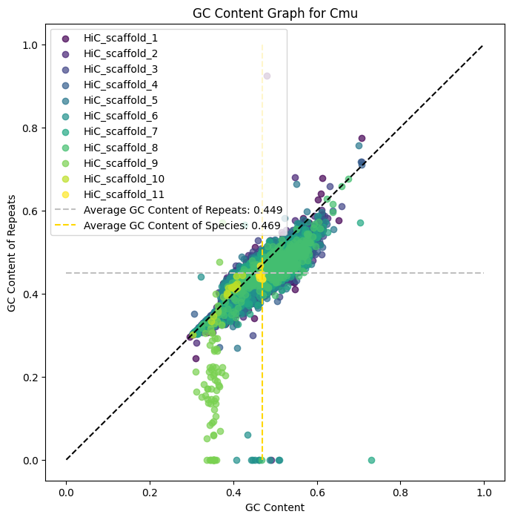

Slide 22
Other Species
C. Elegans: GCF_000002985.6
H. Sapiens: GCF_000001405.40
M. Musculus: GCF_000001635.27
P. Patens: GCF_000002425.4
C. reinhardtii: GCF_000002595.2
A. Thaliana: GCF_000001735.4

Slide 23







Slide 24
Added in other species
Chlorophyta
Micromonas commoda: GCF_000090985.2
Ostreococcus lucimarinus: GCF_000092065.1
Bathycoccus prasinos: GCF_002220235.1
Ostreococcus Tauri: GCF_000214015.3
Chlorella sorokiniana: GCA_025917655.1
Tetraselmis Striata: From lab

Slide 25







Slide 26
More:
Archaea: Thermococcus kodakarensis KOD1: https://www.ncbi.nlm.nih.gov/datasets/genome/GCF_000009965.1/
Amoebozoa: Dictyostelium discoideum AX4: https://www.ncbi.nlm.nih.gov/datasets/genome/GCF_000004695.1/
Mycobacterium tuberculosis H37Rv: https://www.ncbi.nlm.nih.gov/datasets/genome/GCF_000195955.2/
Streptomyces Coelicolor A3(2): https://www.ncbi.nlm.nih.gov/datasets/genome/GCF_008931305.1/
Aspergillus fumigatus: https://www.ncbi.nlm.nih.gov/datasets/genome/GCF_000002655.1/
Oryza Sativa Japonica Group: https://www.ncbi.nlm.nih.gov/datasets/genome/GCF_034140825.1/
Bacillus subtilis subsp. subtilis str. 168: https://www.ncbi.nlm.nih.gov/datasets/genome/GCF_000009045.1/
Haloferax volcanii DS2: https://www.ncbi.nlm.nih.gov/datasets/genome/GCF_000025685.1/
Pyrococcus furiosus DSM 3638: https://www.ncbi.nlm.nih.gov/datasets/genome/GCF_008245085.1/

Slide 27







Slide 28

Repeat Segments are more extreme?
GC Content in repeats seem to increase more rapidly than the overall GC Content for all species
Could be due to faster replication rate
if mutation bias exists
Lack of correlation in data from sliding window analysis contradicts this
if selective pressure
If so, why?
Would not be effected by biased gene conversion, as recombination
Could be due to weaker constraints
Repeats aren’t subject to as many selective constraints
Error: [0.07691182 0.03715188]
Notes:
Try looking at selfish genes

Slide 29
Viruses*
Sars CoV 2: https://www.ncbi.nlm.nih.gov/datasets/genome/GCF_009858895.2/
HIV: https://www.ncbi.nlm.nih.gov/datasets/genome/GCF_000864765.1/
Japanese Encephalitis: https://www.ncbi.nlm.nih.gov/datasets/genome/GCF_000862145.1/
*Can’t mask, sequences too short

Slide 30




Focusing on Eukaryotes
Error for R vs NR: [0.17515199 7.34616462]
Error for R vs Species: [0.07408874 2.96851225]
If $x=y,\frac{46.44866787}{1.97654359−1}=47.56440563$
If $x=y,\frac{20.46971833}{1.43353025−1}=47.21635533$
Error: $47.56440563\sqrt{{\left(\frac{0.17515199}{1.97654259−1}\right)}^{2}+{\left(\frac{7.34616462}{46.44866787}\right)}^{2}}=11.37408807$
Error: $47.21635533\sqrt{{\left(\frac{0.07408874}{1.43353025−1}\right)}^{2}+{\left(\frac{2.96851225}{20.46971833}\right)}^{2}}=10.58281436$
Notes:
Instead of replication:
More constraints on coding aspects of genome -> look at constraint metrics comparison
Maybe compare protein coding vs other functional
For different elements, download ncbi file, or just run myself

Slide 31


Call: lm(formula = masked_gc_content ~ gc_content, data = df) Residuals: Min 1Q Median 3Q Max -10.2002 -2.4081 0.4221 2.3565 8.3815 Coefficients: Estimate Std. Error t value Pr(>|t|) (Intercept) -20.46972 2.96851 -6.896 2.31e-08 *** gc_content 1.43353 0.07409 19.349 < 2e-16 *** --- Signif. codes: 0 ‘***’ 0.001 ‘**’ 0.01 ‘*’ 0.05 ‘.’ 0.1 ‘ ’ 1 Residual standard error: 3.997 on 41 degrees of freedom Multiple R-squared: 0.9013, Adjusted R-squared: 0.8989 F-statistic: 374.4 on 1 and 41 DF, p-value: < 2.2e-16
Call: lm(formula = masked_gc_content ~ unmasked_gc_content, data = df) Residuals: Min 1Q Median 3Q Max -13.1258 -4.1637 0.7848 3.1862 13.4383 Coefficients: Estimate Std. Error t value Pr(>|t|) (Intercept) -46.4487 7.3462 -6.323 1.50e-07 unmasked_gc_content 1.9765 0.1752 11.285 3.76e-14 (Intercept) *** unmasked_gc_content *** --- Signif. codes: 0 ‘***’ 0.001 ‘**’ 0.01 ‘*’ 0.05 ‘.’ 0.1 ‘ ’ 1 Residual standard error: 6.278 on 41 degrees of freedom Multiple R-squared: 0.7565, Adjusted R-squared: 0.7505 F-statistic: 127.3 on 1 and 41 DF, p-value: 3.761e-14

Slide 32











Histograms for detecting HGT?
Initial Observations
Compositional Domains exist in S. roscoffensis
Small subset of high GC genes seem to exist
Don’t know if horizontal gene transfer would conserve GC content to an extent where you can use it as a test

